Slide 1


Slide 2
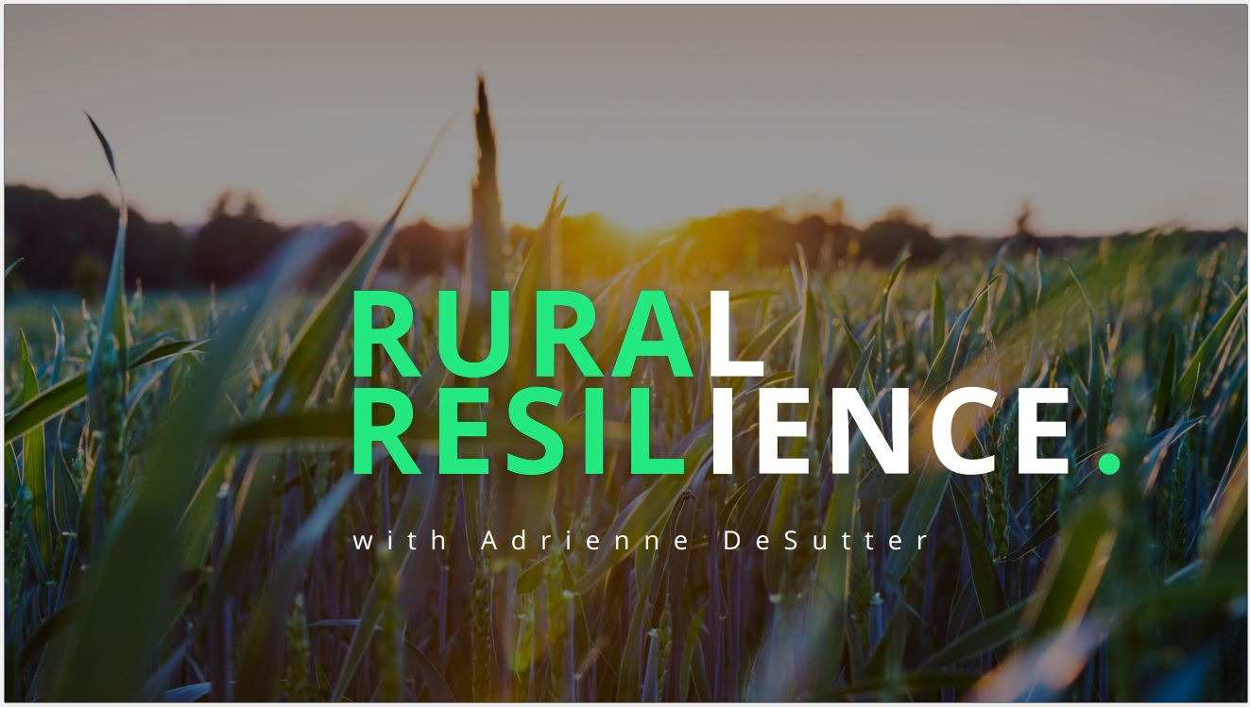

Slide 3
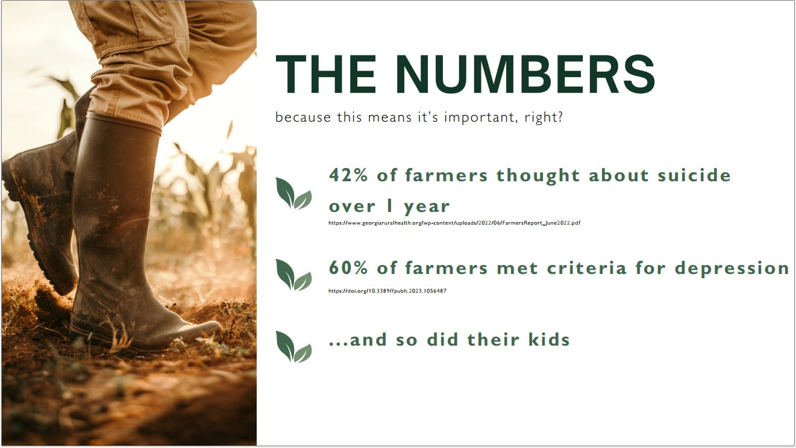

Slide 4
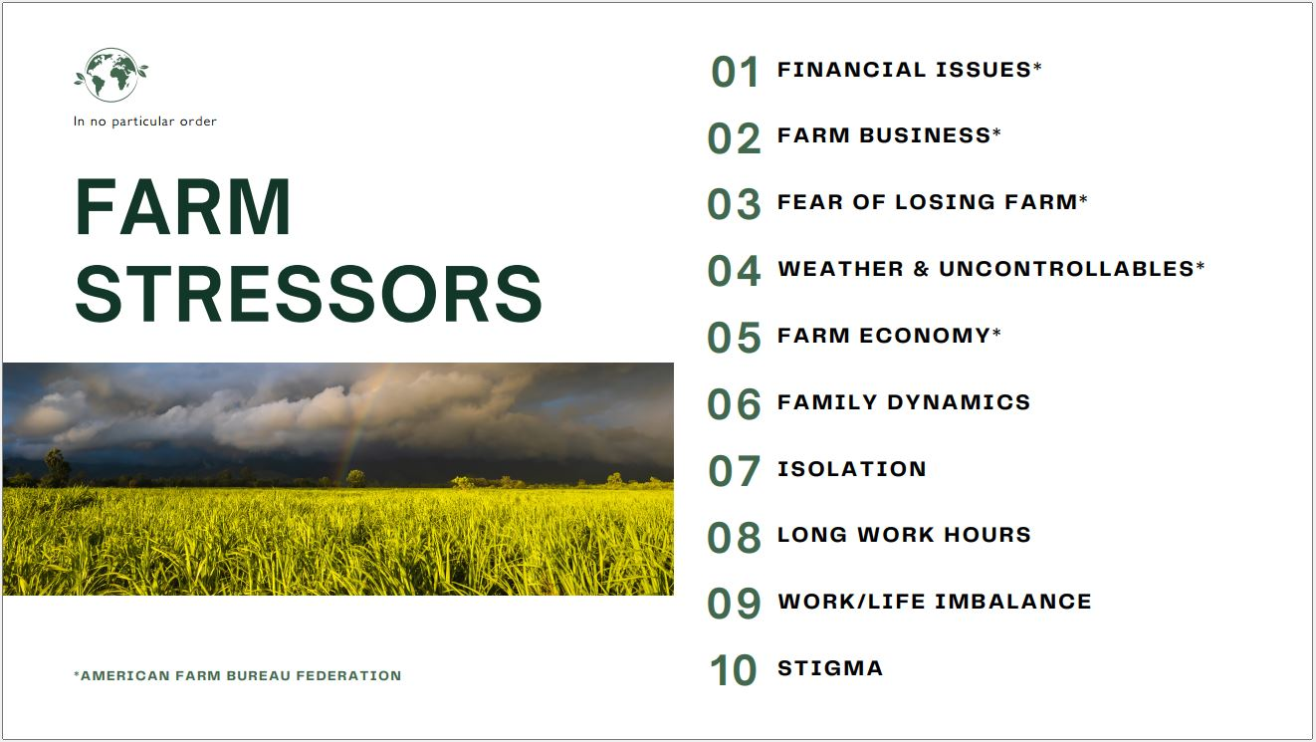

Slide 5
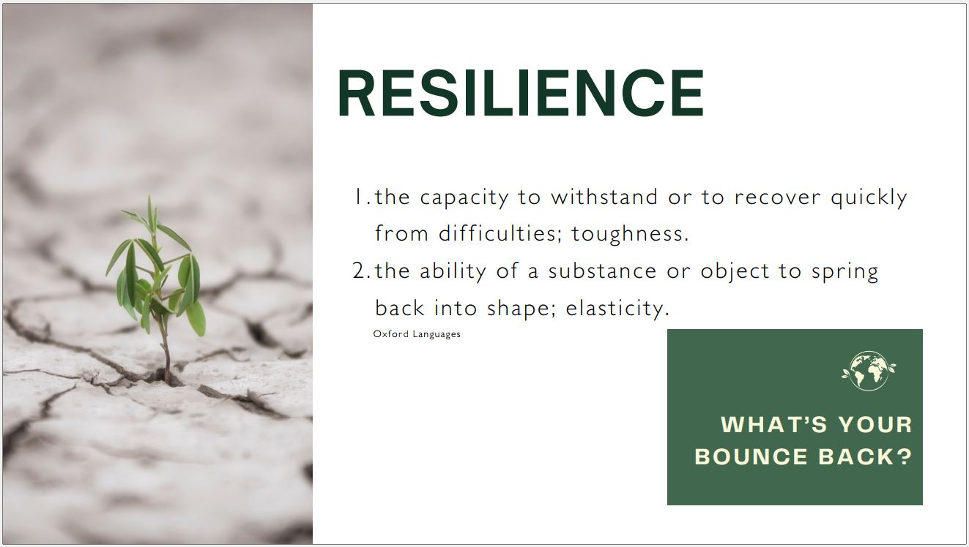

Slide 6
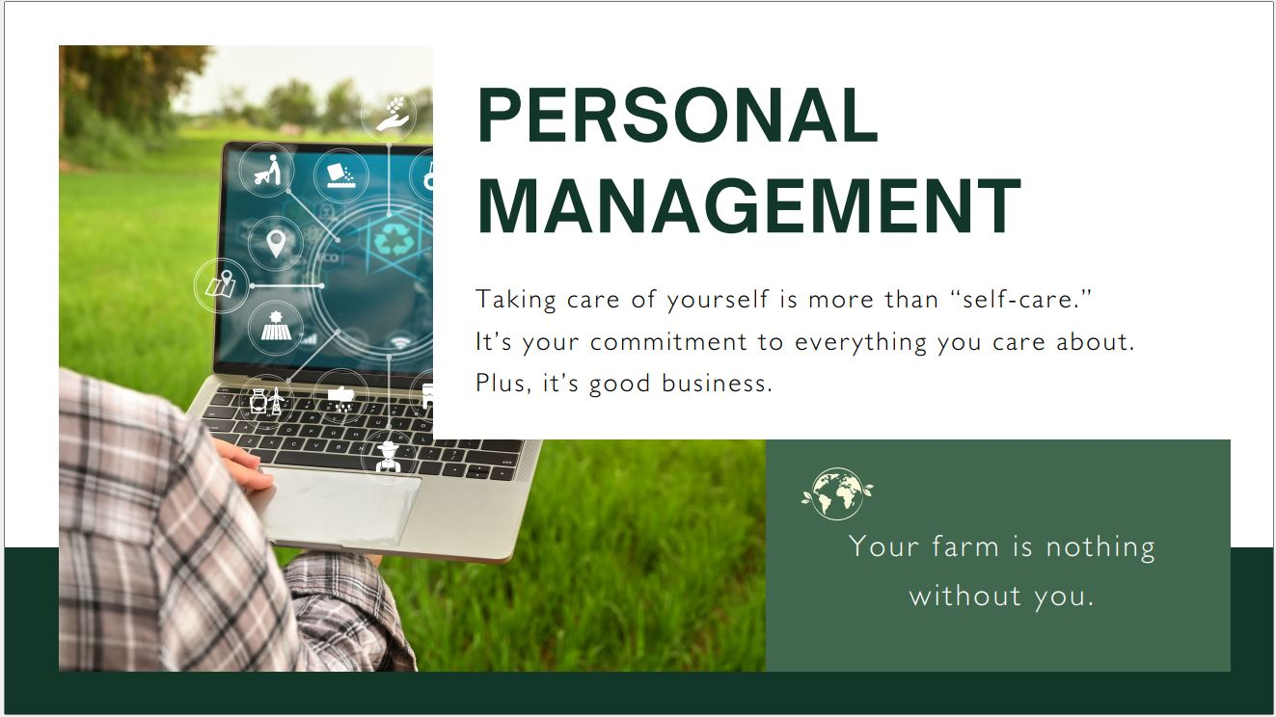

Slide 7


Slide 8
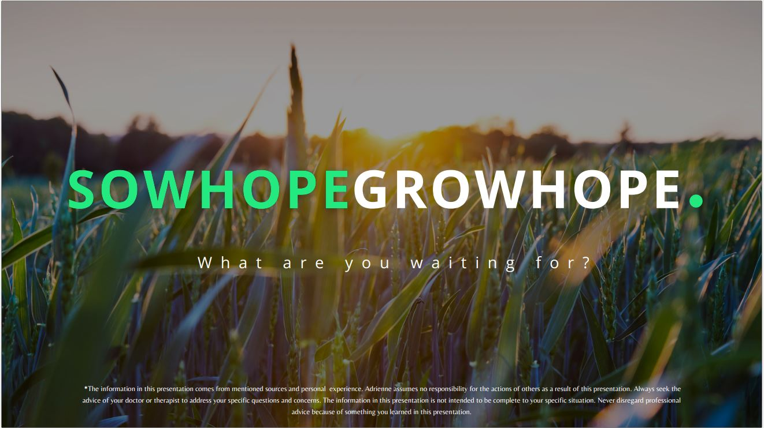

Slide 10
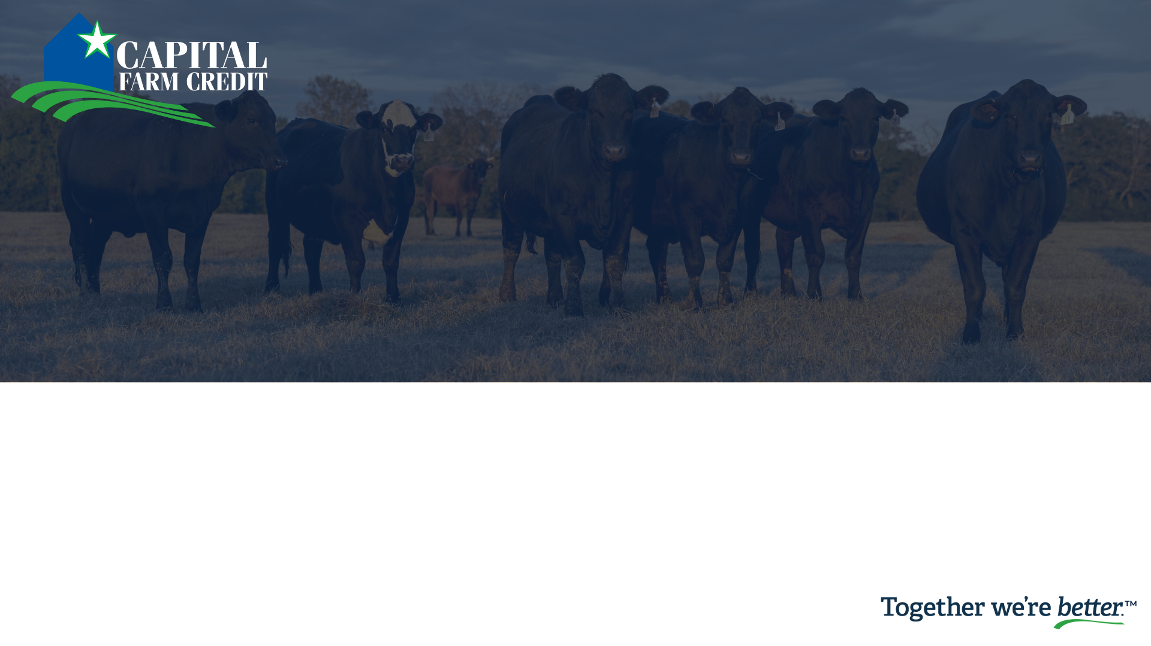
Insurance Services Group
Risk Management Options from Capital Farm Credit
Daniel Wright, Jared Flores, &
Jake Surman

Slide 11

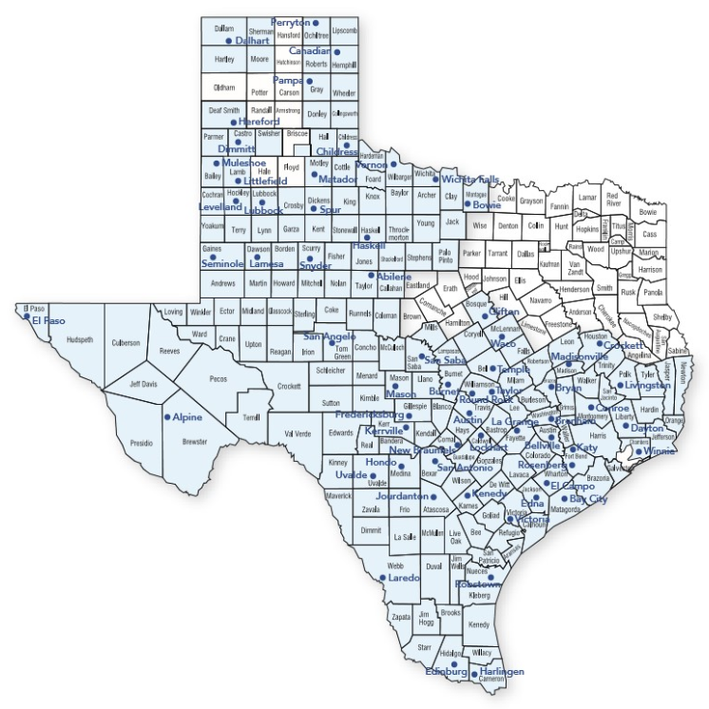
Insurance Services
Experienced Agent Team
Experienced Administrative Team
Ability to write policies in several states

Slide 12




Insurance Services
Insurance Providers Where We Place Business:
  RCIS – Owned By Zurich Insurance Group
  A.M. Best Rating – A+
  Great American Insurance Group
  A.M. Best Rating – A+
  AgriSompo
  A.M. Best Rating – A+
  Rain & Hail – Owned by Chubb Insurance
    A.M. Best Rating – A++
Notes:
There are 14 AIPs in the United States.
AgriSompo is the Third Largest AIP
Zurich Insurance Group is the Fourth Largest AIP
Great American Insurance Group is the Fifth Largest AIP

Slide 13
Insurance Options
Crop Insurance:
  Multi-Peril (MPCI)
  Crop Hail
Livestock Insurance:
  Pasture, Rangeland and Forage (PRF)
  Livestock Risk Protection (LRP)
  Livestock Gross Margin (LGM)
  Dairy Revenue Protection (DRP)

Slide 14

Crop Risk Management Options

Slide 15
Multi-Peril Crop Insurance (MPCI)
Insurance available for over 120 crops
Subsidized Premium – Must be in Compliance (AD-1026 on File)
Beginning Farmers and Ranchers (5 Years or Less) – Additional 10% Subsidy
Coverage options include, but not limited to, yield and price protection guarding farmers against potential loss in revenue from low yields or changes in market price
Spring Sales Deadline: January 31 - March 15 (depending on area)
Fall Sales Deadline: September 30th

Slide 16
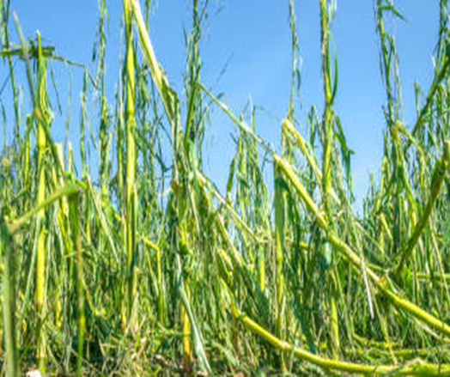
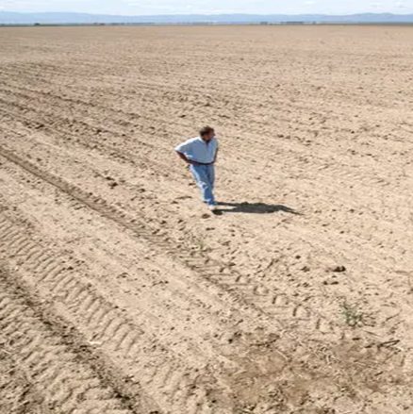
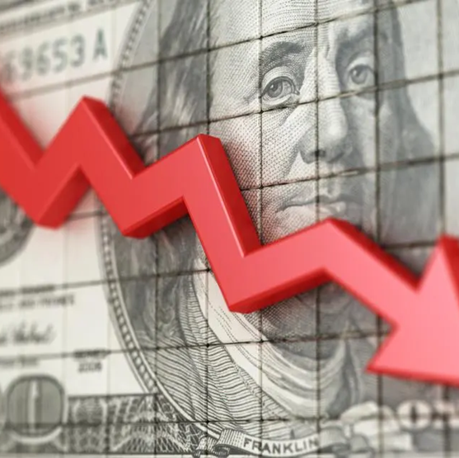
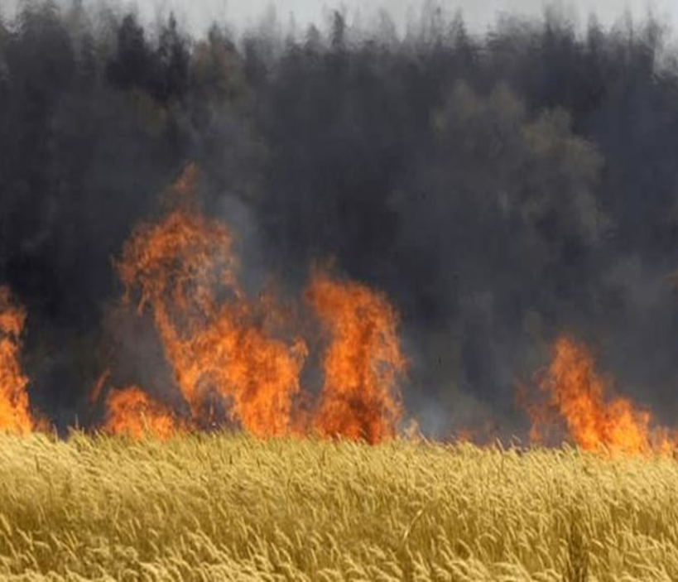
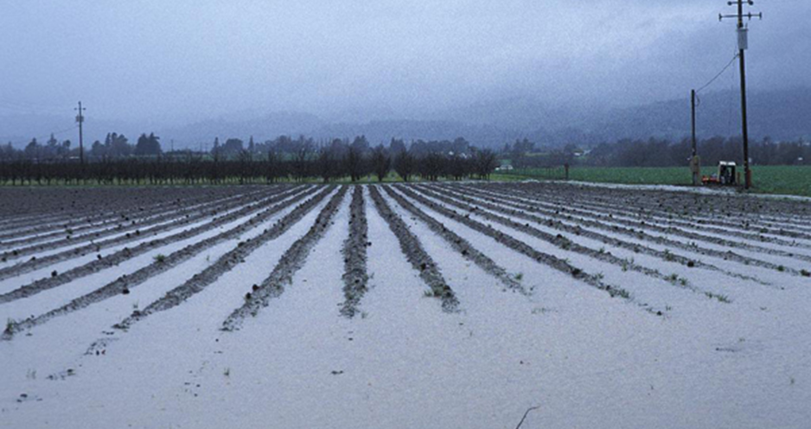
Common
Multi-Peril Covered Perils:
Drought
Heat
Excess Moisture/Precipitation
Failure of Irrigation Water Supply
Market Price Changes (Revenue Protection)

Slide 17
Crop Hail Insurance
Protects against physical damage caused by hail
Policies provided directly to farmers by private insurance companies
Multiple coverage provider options
Claims paid on acre-by-acre basis
Sales Deadline: Anytime during the growing season

Slide 18
Livestock Risk Management Options

Slide 19
Pasture, Rangeland, & Forage (PRF)
Protects hay and livestock producers against loss of forage, due to lack of rainfall, on acres used for grazing and hay.
Choose between two to six 2-month intervals in which precipitation is important to the operation.
Many ranchers can qualify: no yields needed, based off acres (no minimums).
No loss adjustment. Based on NOAA data.
Sales Deadline: December 1st

Slide 20
Pasture, Rangeland, & Forage (PRF)
The rainfall index uses National Oceanic and Atmospheric Administration Climate Prediction Center (NOAA CPC) data for the grid where the property is located.
Insurance payments are determined using NOAA CPC data for the grids and index intervals you choose to insure. When the final grid index falls below your "trigger grid index," you may receive an indemnity for lack of precipitation.
Coverage is based on the experience of the entire grid – not on an individual farm or ranch or a specific weather station in the general area.

Slide 21
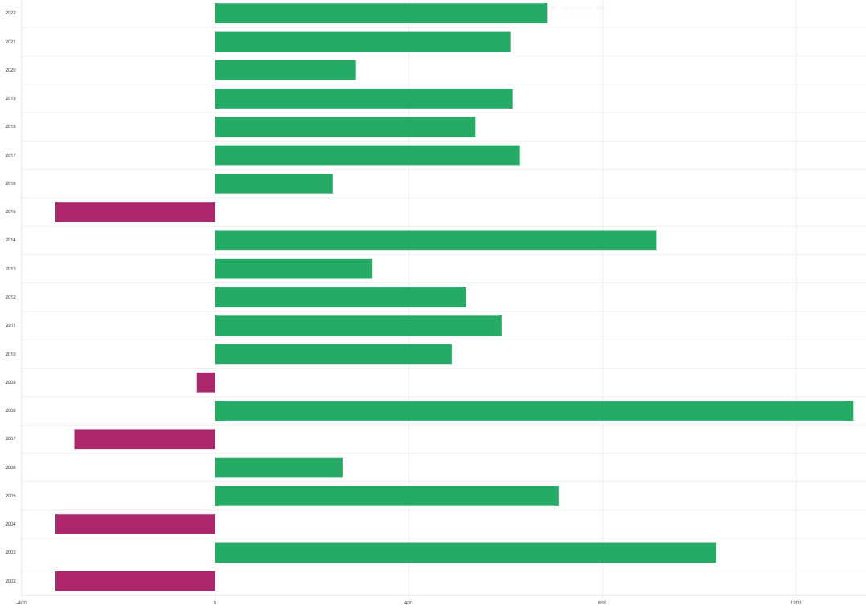
Pasture, Rangeland, & Forage (PRF)
We can run custom quotes, including historical averages and optimizer tools to help customers select the best intervals for their operation.
Indemnity Chart- Hale County, Grid 16613, 20-year history:

Slide 22
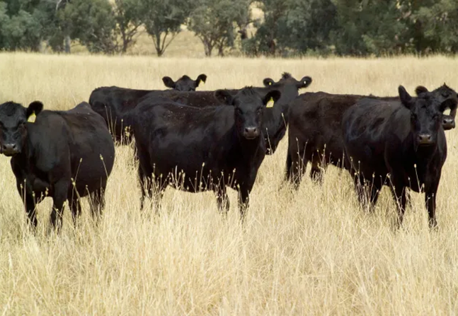
Livestock Risk Protection (LRP)
A price-risk management tool to cover against declining market prices.
Producers may choose from a variety of coverage levels and insurance periods to correspond with sell times of market weights.
Available for feeder cattle, fed cattle and swine.
Sales Deadline: Available anytime

Slide 23
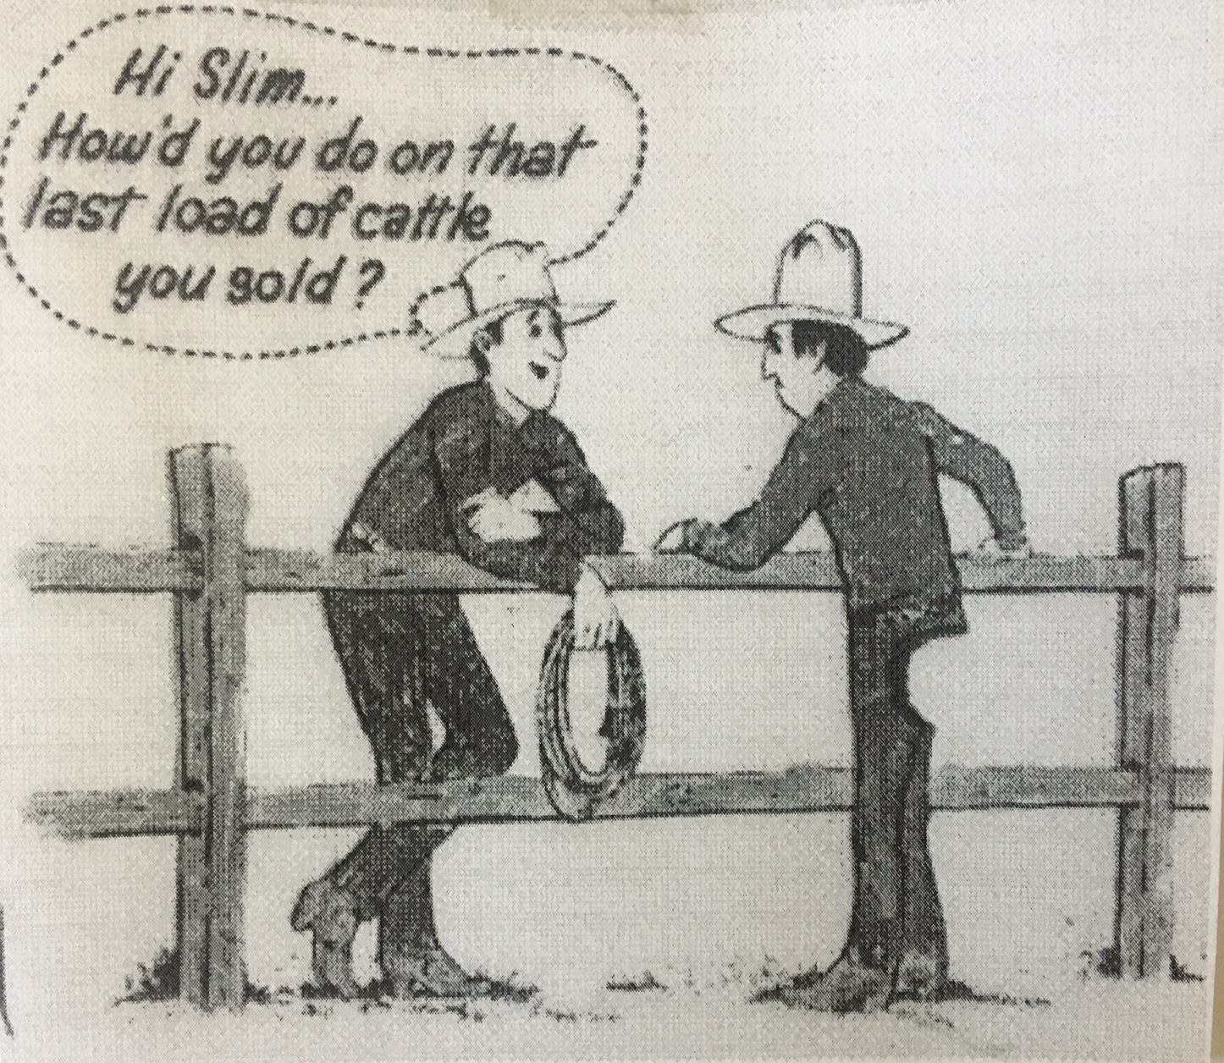
Livestock Risk Protection (LRP)
2 Step Process:
Application (free to complete)
Specific Coverage Endorsement: contains the details of the coverage

Slide 24
Livestock Gross Margin (LGM)
Cattle insurance policy using futures prices to determine expected gross margin and the actual gross margin.
Policy doesn’t insure against death loss or any other loss or damage to producer’s cattle.
Options available for cattle, dairy and swine.
Sales Deadline: Available anytime

Slide 25
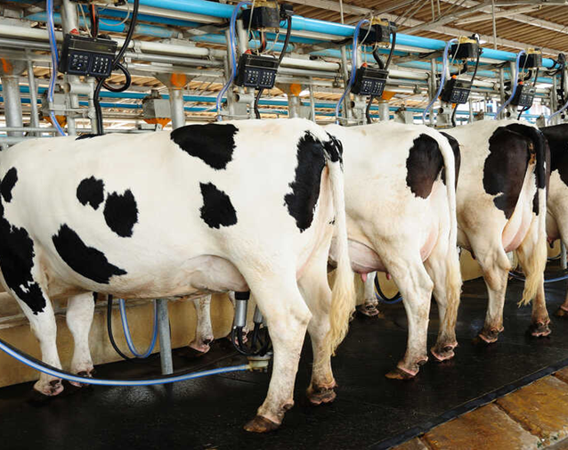
Dairy Revenue Protection (DRP)
Risk management tool insuring against declines in quarterly revenue from milk sales.
Select from a variety of coverage levels and pricing by class or component
Sales Deadline: Available anytime

Slide 26
Conclusion
Insurance for producers is a critical component of managing their operations.
Market movement can be volatile putting producers in tough positions.
Successful producers utilize insurance as a risk management tool and understand the value of partnering with a trusted agent and lender.
Insurance products are continually changing and evolving.
How can we help you minimize your risk?

Slide 27

Questions?
www.CapitalFarmCredit.com

Slide 28


Purpose-Driven Branding & Marketing 101
The applied science and bewitchery of creating a brand that stands out, builds trust and drives action.

Slide 29


What is a brand to you?
a name, trademark, logo, or product.
Branding is the culture itself. Your story is the message that drives your business.
Marketing is the set of processes and tools promoting your business.

Slide 30

"A brand is no longer what we tell the consumer it is - it is what the consumers tell each other it is."
Scott Cook, co-founder of Intuit

Slide 31
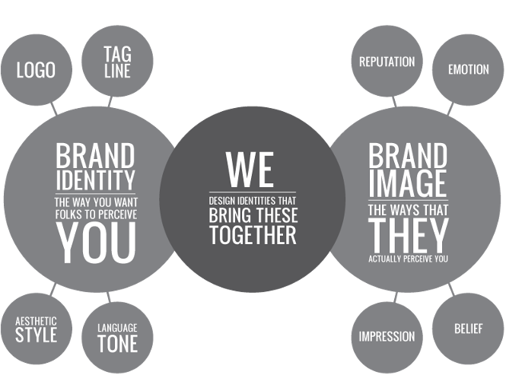
Your Brand Story

Slide 32
Why is establishing a brand important?
Sets tone and precedence
Identity

Slide 33

A Brand is Both Tangible and Intangible
Intangible = Perception
Audience driven
Thoughts, feelings
Tangible = Physical
You control:
Color, Shape, Size, Packaging, Voice, Visuals, Mission
Your decisions on tangible aspects, impacts your intangibility.

Slide 34
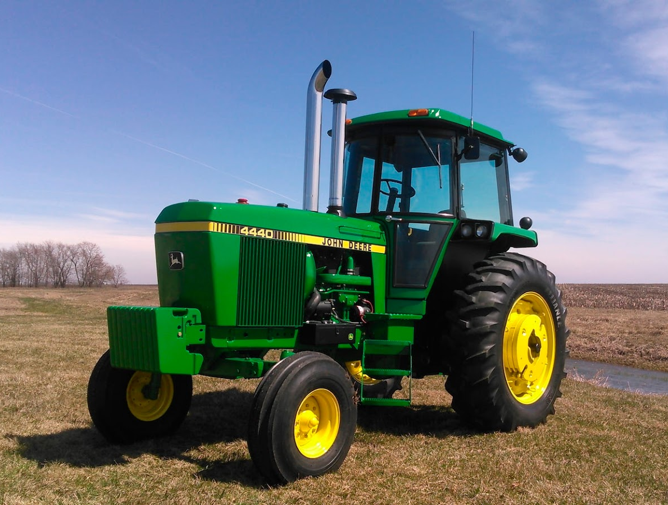

Tangible: Green vs. Red
Intangible: Which one is better?

Slide 35
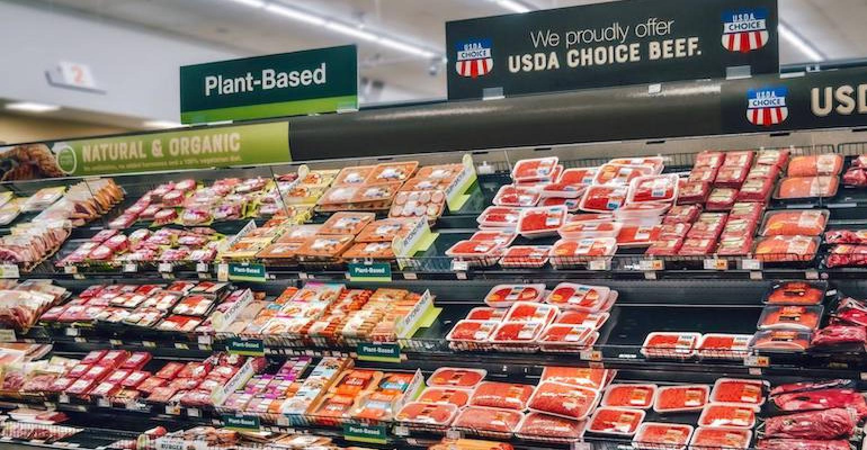
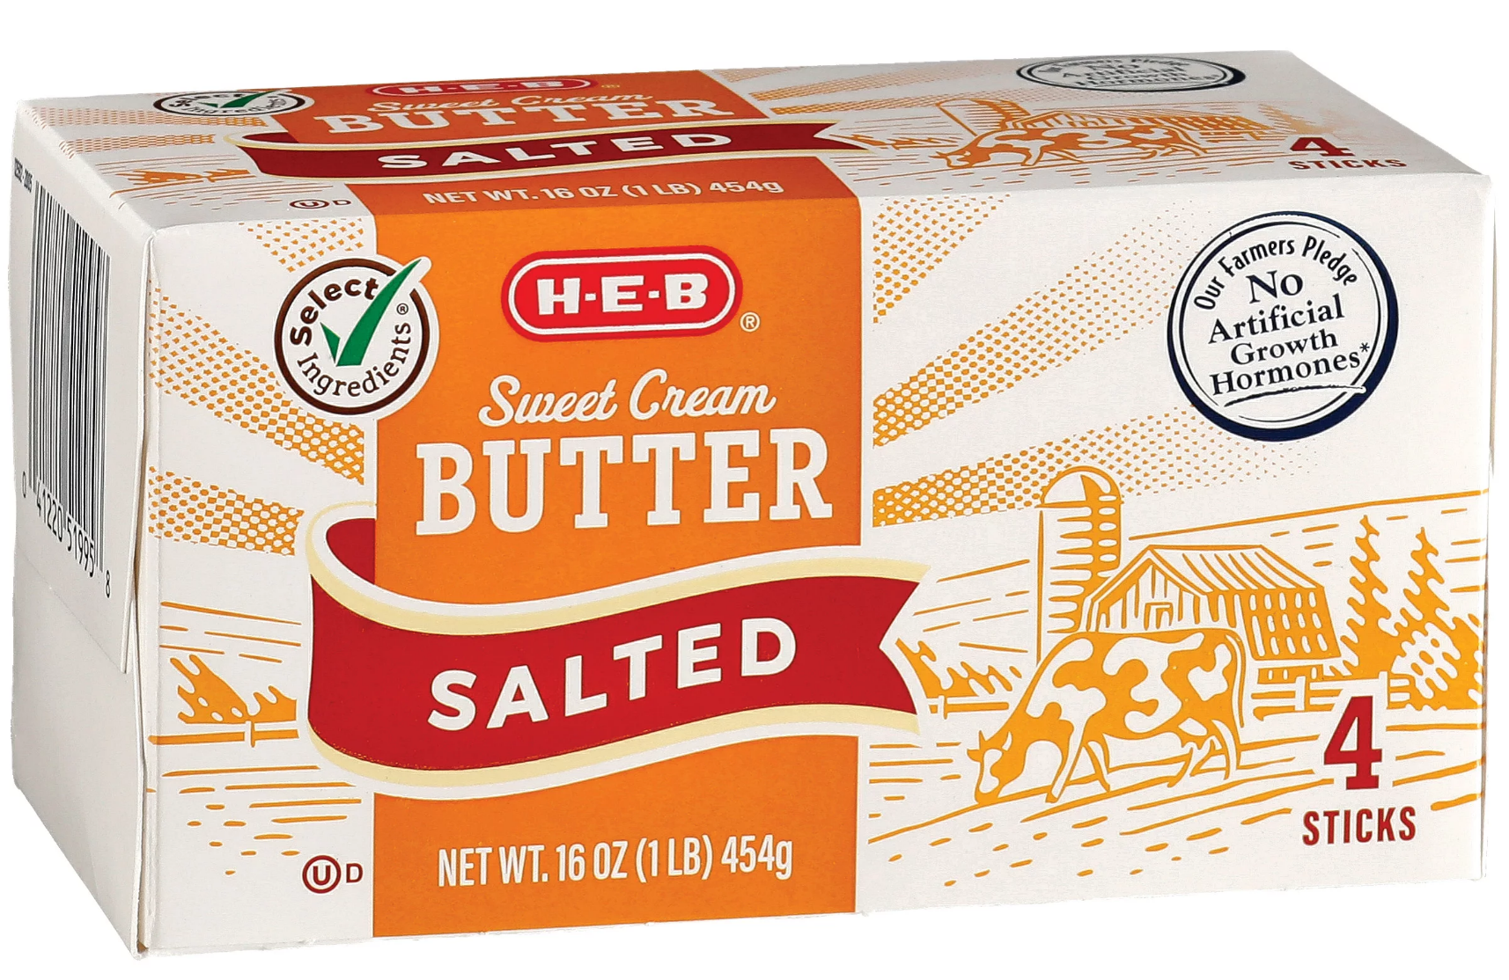
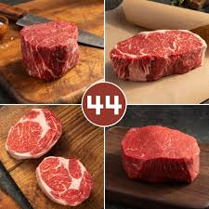
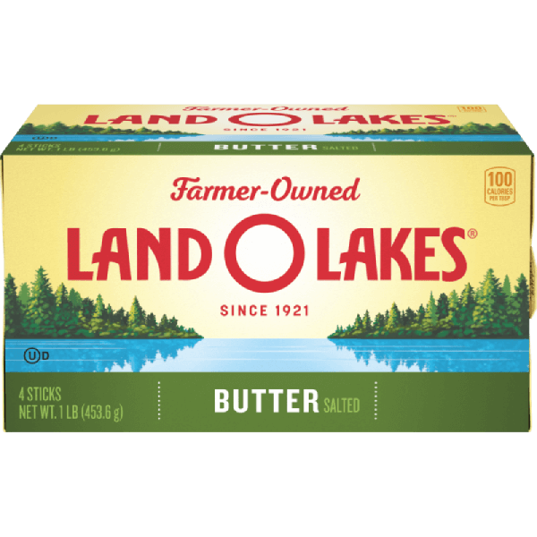

Commodities
Interchangeable?
What differentiates?
Beef is beef.
Unless you perceive a difference.

Slide 36
Let’s Talk HOW to Build a Brand
  Research
    Audience
    SWOT
    Market Conditions
    Competitors
  Brand Identity
    Purpose
    Mission/Core Values
    Archetypes/Voice
    Colors
  Design of Brand Mark
  Create Your Brand Story

Slide 37
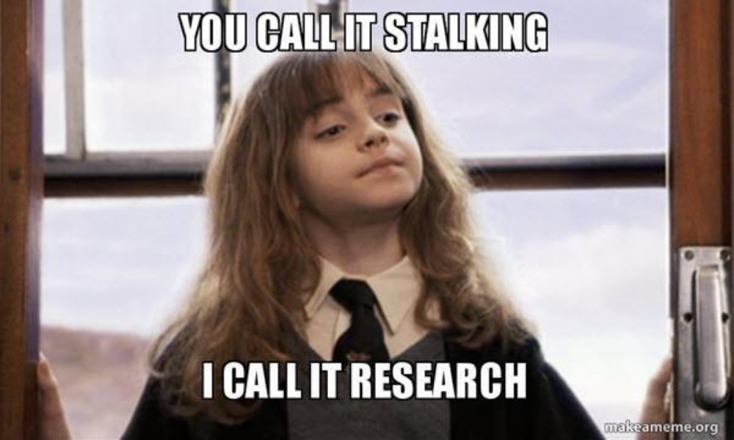
Market Research

Slide 38
Let's Find Out Who We’re
Talking to
Defining Target Audiences
  Start with a close look at who
    Demographics
  What information is your audience looking for
  What are their goals and values
  Where do they go for information
  What do they do for a living
  What are their challenges and pain points
  What are their objections

Slide 39

Who Are You Talking To?
Defining Your Target Audience(s)
It's important to know who you're talking to and more importantly, how to talk to them.
Audience(s) vs Community
Once you know who you want to talk with, it's important to focus on being present where they already are.
What is Success for Your Target Audience
Interactions and engagements are less about your needs and what you do, and more about what's important to your audience. What are their concerns, pain points and issues.

Slide 40
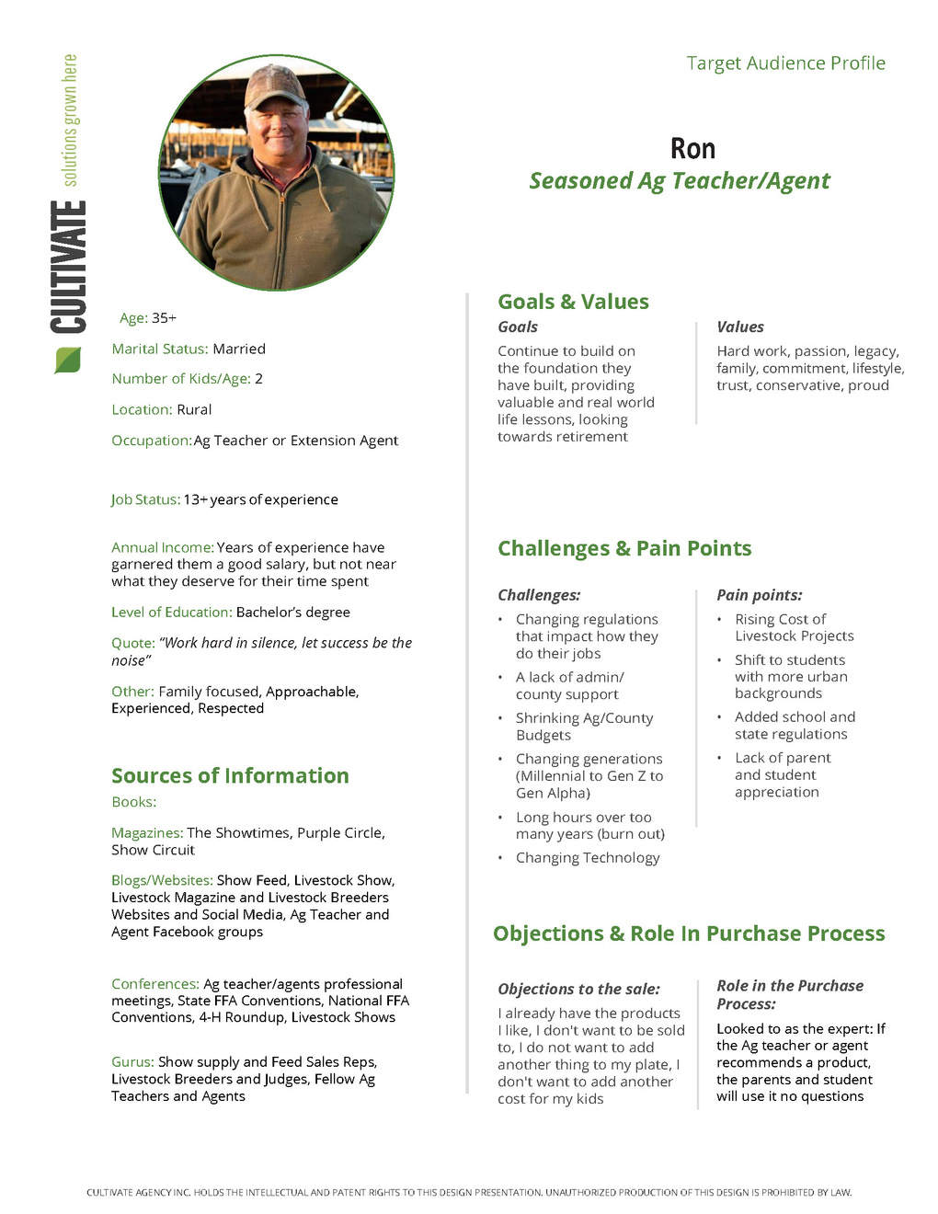
Audience
Profile

Slide 41
SWOT Analysis
Accessing your risks and finding your opportunities
Now that we know our product and who we will market it to, we need to conduct a SWOT (strengths, weaknesses, opportunities, threats) analysis before deciding what and how we will communicate with potential customers.
  Strengths
    What we are good at
    What makes us stand out
  Weaknesses
    What do we need to fix
    What can we become more efficient at
  Opportunities
    What will the industry soon need
    What can make us stand out
  Threats
    What could hinder our growth
    What/who could take our customers?

Slide 42
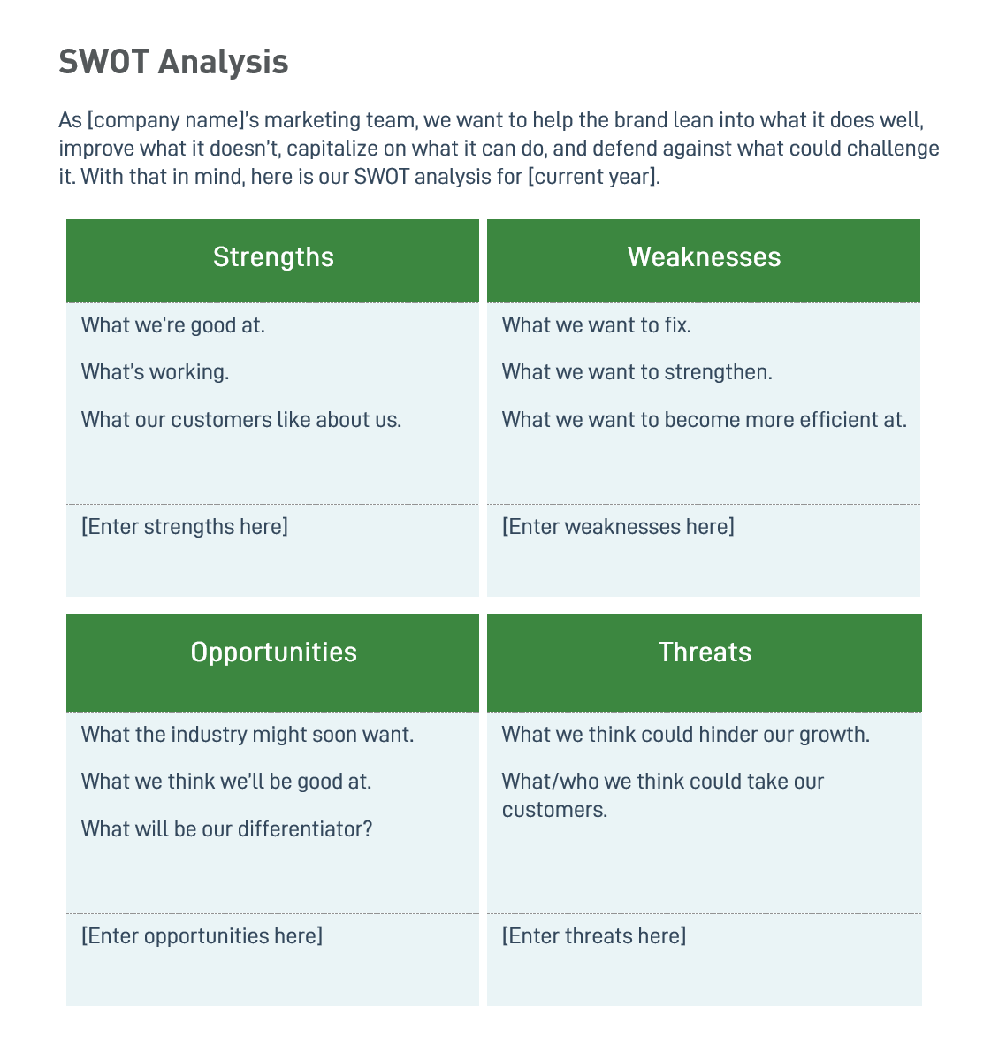

Slide 43
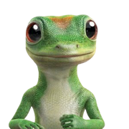


Brand Identity: Purpose & Mission
Brand Purpose
One sentence that communicates the value you create in the lives of your customers.
Geico: “15 minutes or less can save you 15% or more on car insurance.”
Apple: “Think different.”
Walmart: “Save money. Live better.”

Slide 44
Brand Identity: Core Values
Brand Values
Four to five values that matter to your company. Great brand values should set you apart from other brands. Try to keep them clear and concise.
Chick-fil-A
Customer-first, Personal excellence, Servant leadership, Continuous learning, Stewardship
Adidas
Performance, Passion, Integrity, Diversity
Capital Farm Credit
Commitment, Trust, Value, Family

Slide 45

Building Your Story

Slide 46
Every brand has a story.
Story = collection of your thoughts
+ feelings/experiences with it.

Slide 47
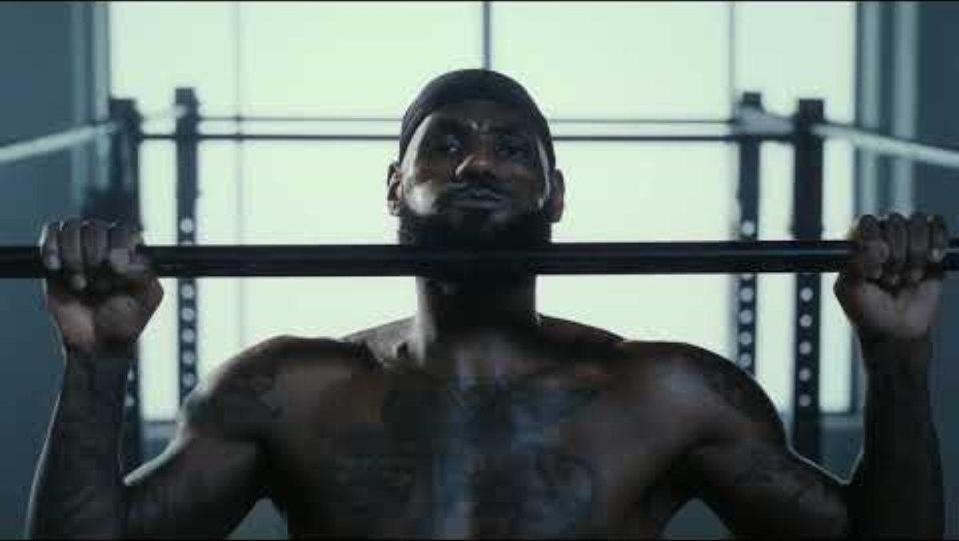
Every brand has a story.
Story = collection of your thoughts
+ feelings/experiences with it.

Slide 48
6
Considerations for your brand story.

Slide 49
The uniqueness of a brand is how it is different from competitors.
People make decisions based on how things makes them feel – unique, powerful, smarter, faster, etc.– not how they are same.
THINGS YOU WILL NEVER HEAR SOMEONE SAY:
“I picked it because it was exactly like every other tractor I test-drove.”
“We bought it because it was exactly like every other bull in the sale.”
“I married him because he was exactly like every other guy I dated.”

Slide 50
1. Unique
The primary reason your audience chooses your brand over the competitors.
2. Experiential
Brands capture what the audience feels during an experience with the brand.
3. Meaningful
Your brand story isn’t about you, its about your customer. Stories that don’t connect are the reason behind many failed brands.

Slide 51
4. Single-minded
A brand becomes stronger, when you narrow the focus.
5. Consistently Delivered
Consistency of experience is the basis for brand loyalty.
6. Authentic
The brand must be credible, or the brand will be rejected.

Slide 52
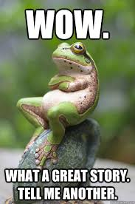
Creating Your Brand Story
Constructing the Right Message Matters
Your message needs to resonate with your audience and force them to have a reaction.
Elements of a Successful Story
You are not the hero of your story. Product attributes are not a story.
Customizing Your Story
Think about what you want to share about HOW your product/service helps your audience.

Slide 53
Build Your Story
The ABT Method
Helps narrow the problem and the solution into a concise statement while connecting with your audience and inviting further engagement.
And = Agreement statement
Raise the stakes
Validates your audience
But = Identify the problem
Succinct
Critical – signifies change is coming
Therefore = Reveal the solution
Explain what your audience needs to overcome their problem

Slide 54
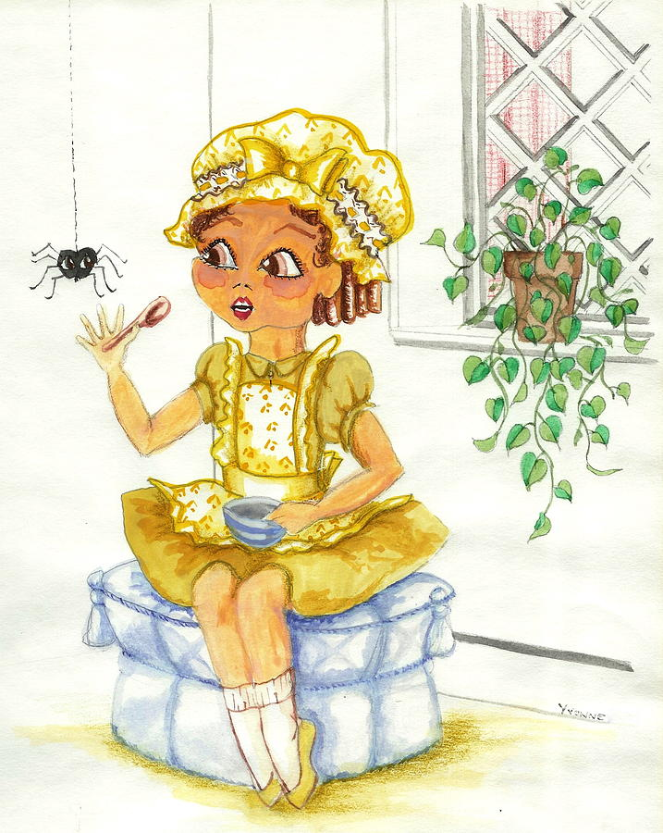
The ABT Method:
Little Miss Muffet
Sat on a tuffet,
Eating her curds and whey.
Along came a spider,
Who sat down beside her,
And frightened Miss Muffet away.
And
But
Therefore

Slide 55
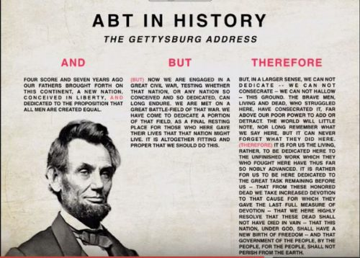
The ABT Method:

Slide 56
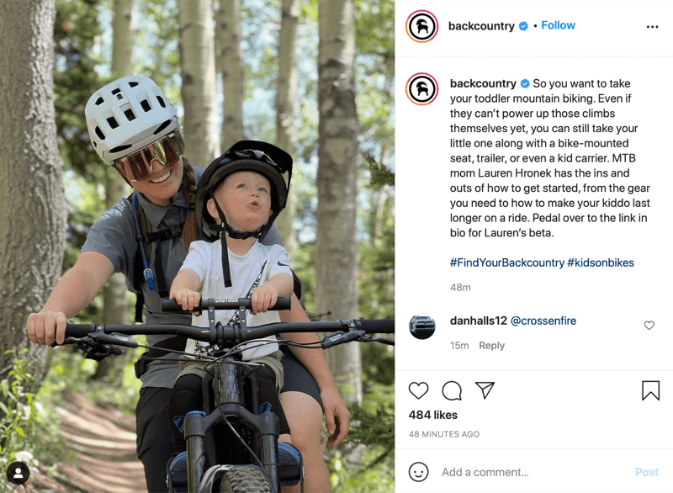
The ABT Method:

Slide 57
Build Your Story
Set the scene
Agreement statement
And
Problem statement
But
Solution
Therefore

Slide 58
Sharing Your Story

Slide 59

Share Your Story
Online
Website, Blog, Social Media, Digital Ads, Radio
Analogue
Print Publications, Radio, PR, Signage
In-Person
    Farmers Market, Industry Meetings/Events

Slide 60
Questions?

Slide 61
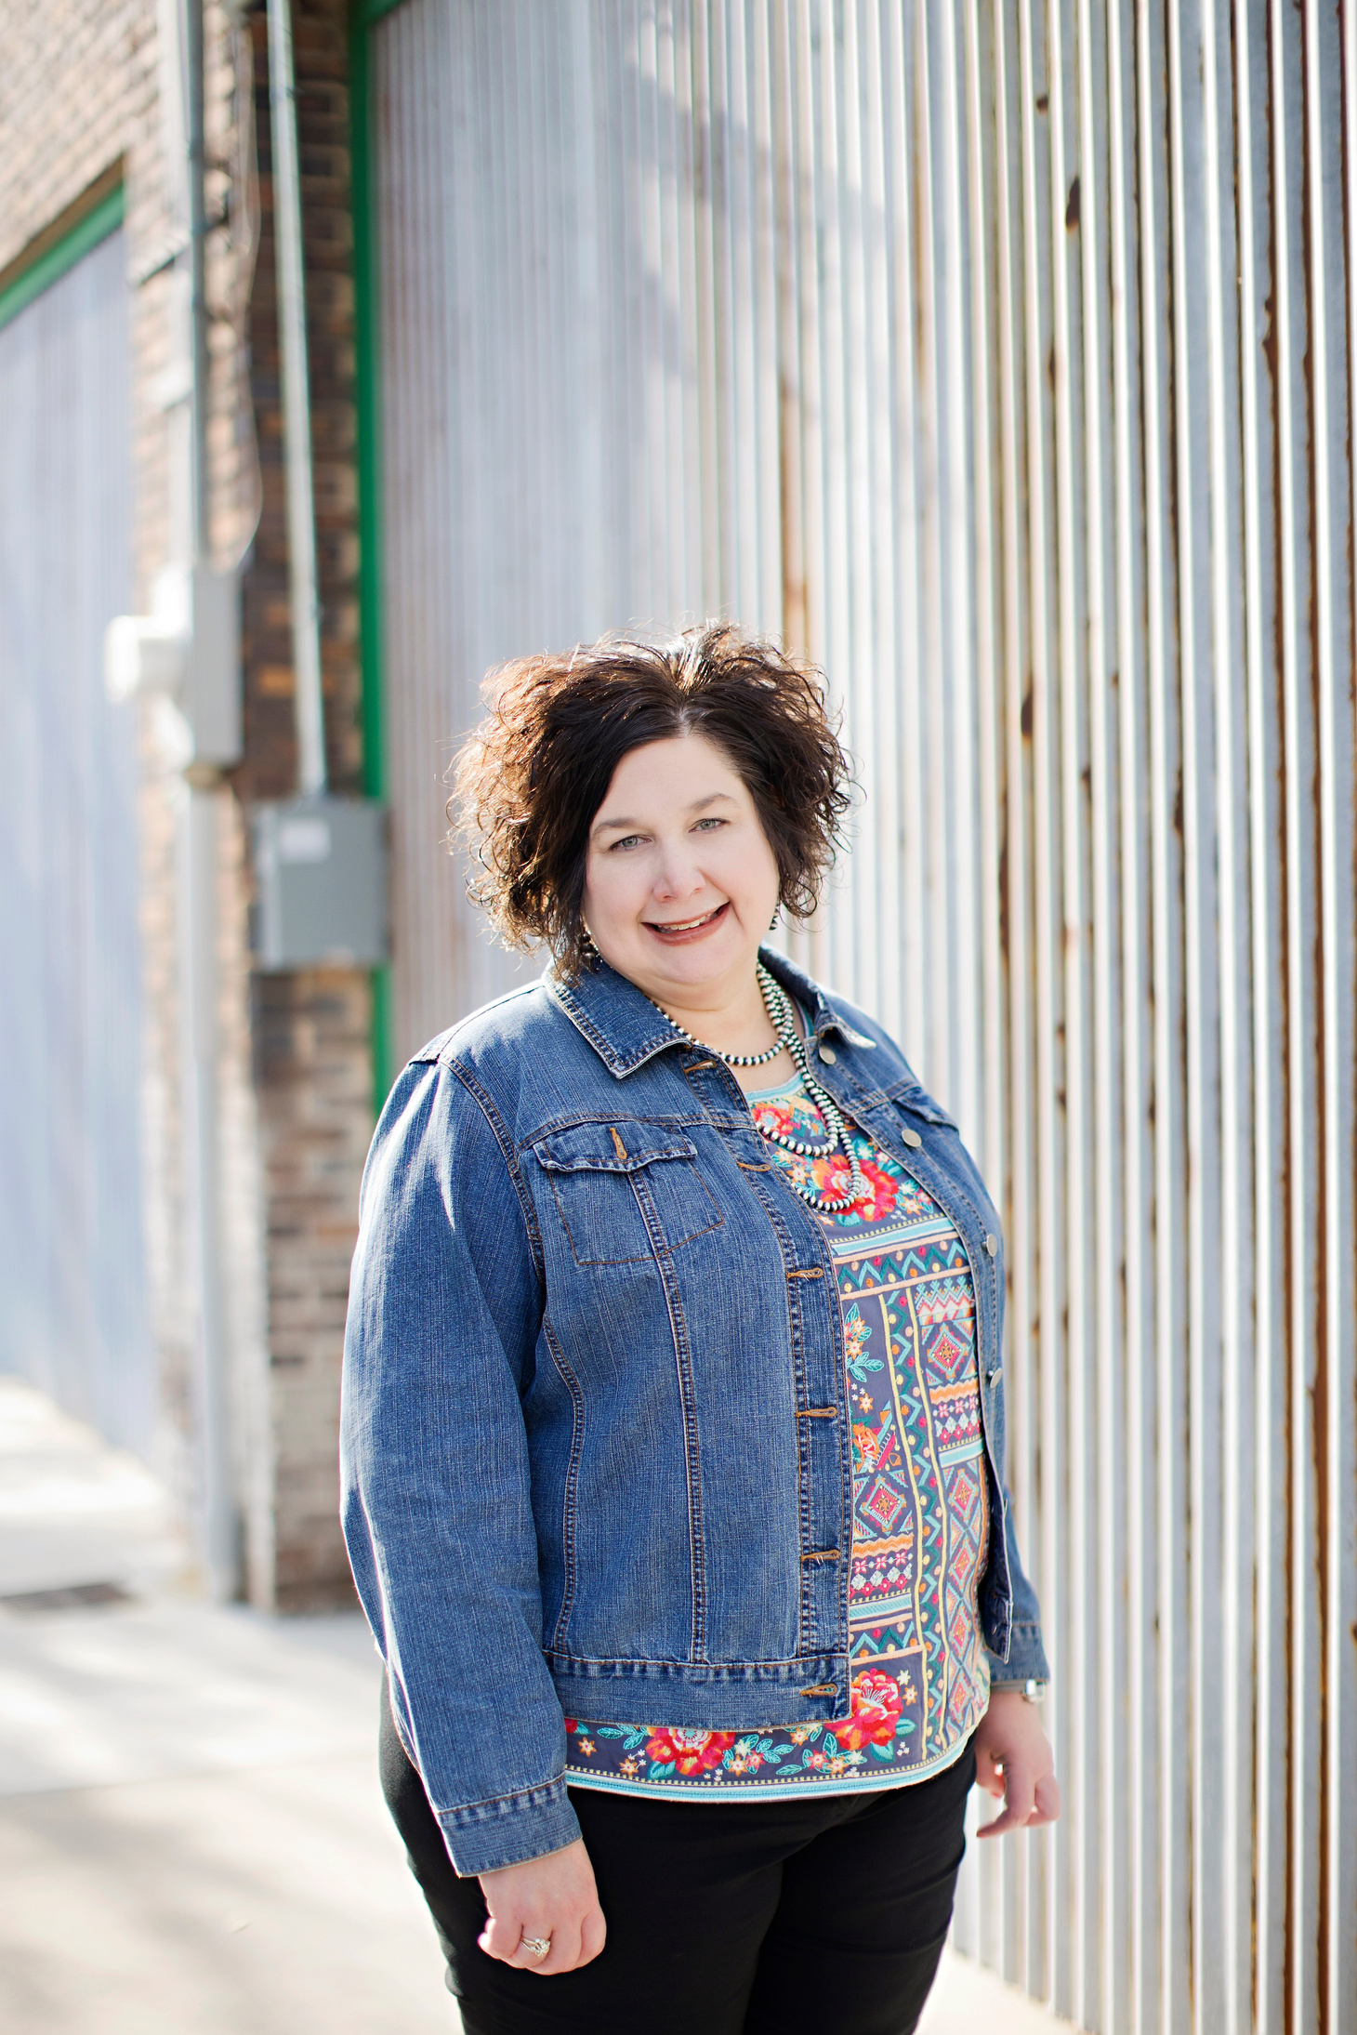
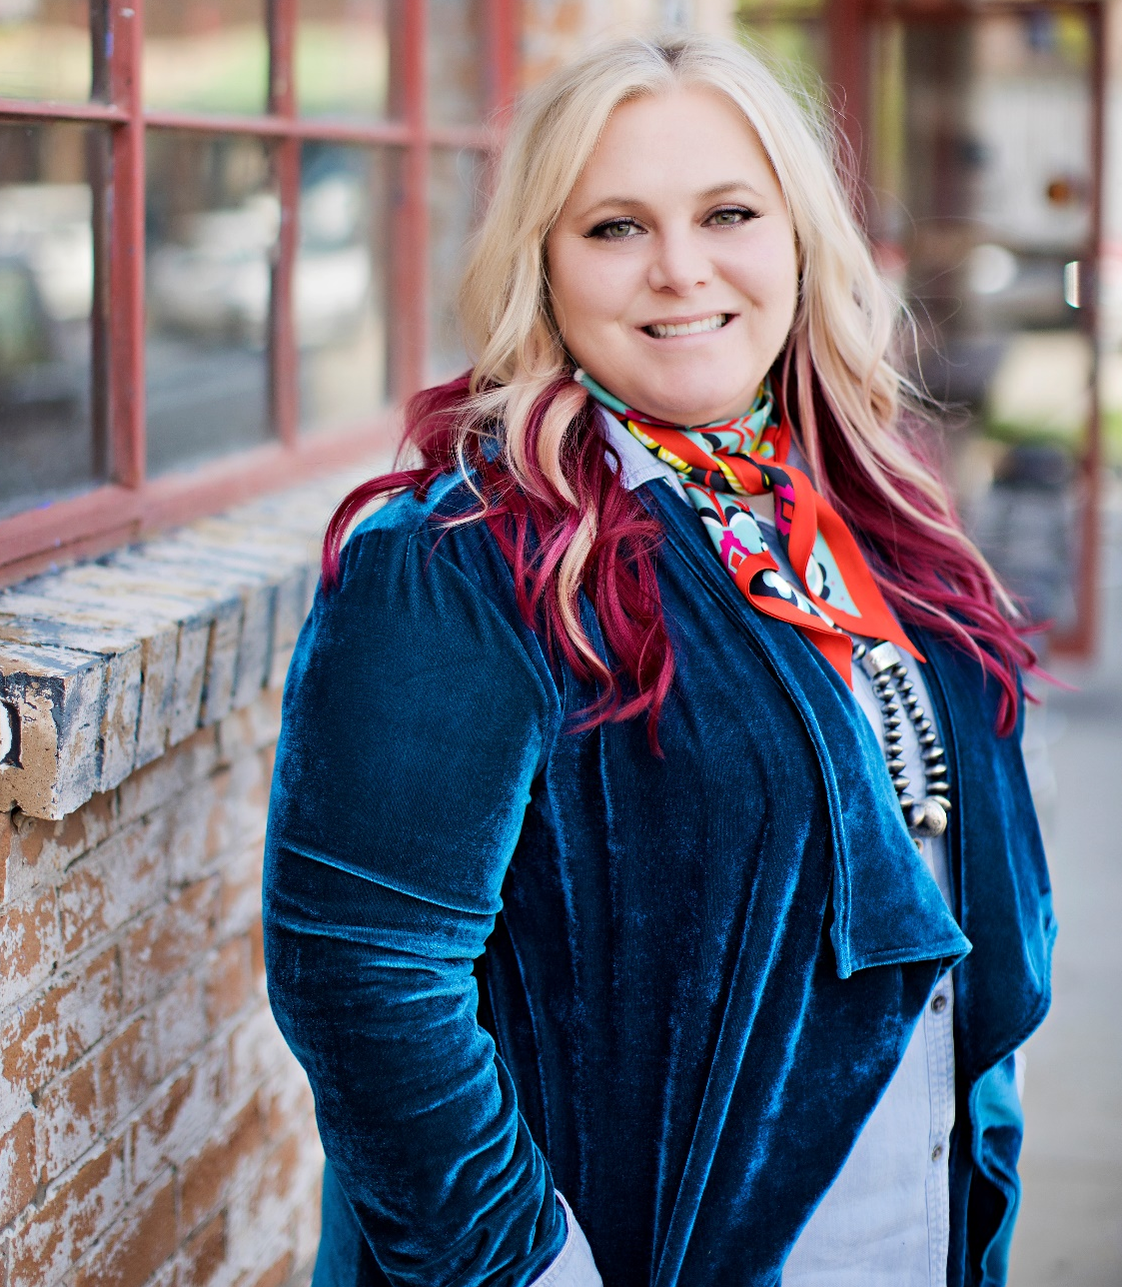
Anne Kimmey
Katy Kemp
anne@cultivateagency.com
katy@cultivateagency.com

Slide 62
Thank you
cultivateagency.com

Slide 64
Loan Programs & Grants Panel
Laura Martinez, Moderator
Kat Nielson, Texas Department of Agriculture
Taylor Berger, USDA & FDA

