Slide 1
Young, Beginning and Small (YBS)
Any Borrower Under the age of 35
Young
Any Borrower with less than 10 years experience
Beginning
Any borrower grossing less than $250,000 in a calendar year
Small
Apply Here

Slide 2
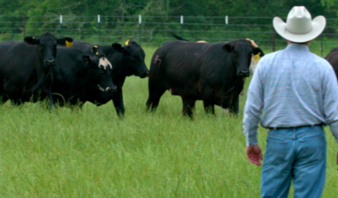
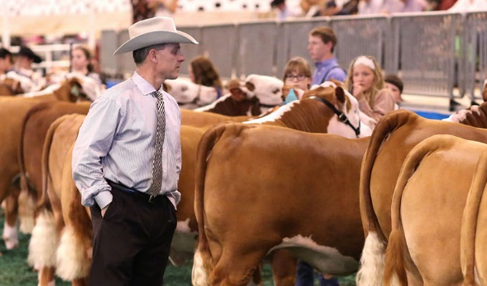
YBS Loan Programs
NextGen
    Must be Y, B and/or S
    Possesses an agricultural foundation and access to Mentorship
    Typically continuing or starting from existing operation
AgVista (Start Up)
    Must be Y, B and/or S
    Benefits from education/experience
    Underrepresented producers
AgStart
    4-H/FFA Youth
    Project and General Purpose

Slide 3
Young, Beginning and Small (YBS)

