Slide 1
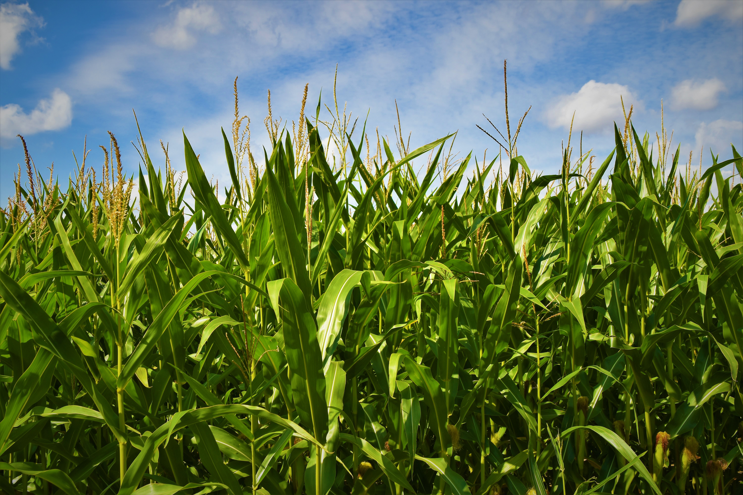
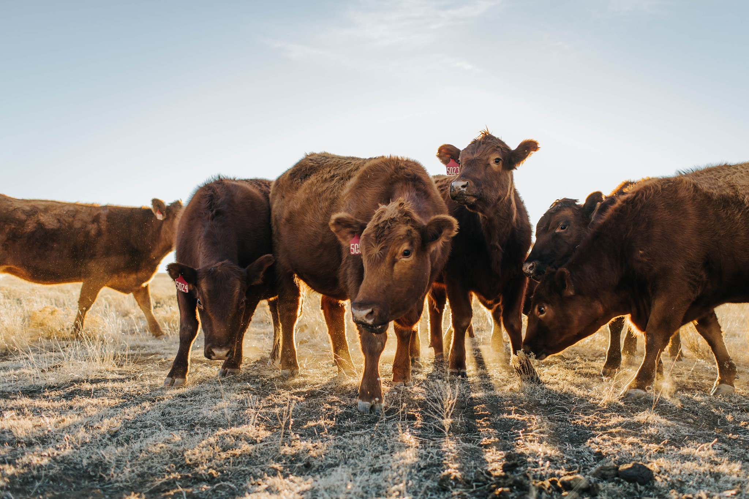
Succession Planning:
Are You Ready?
Capital Farm Credit AgriRoots Conference ● Aug. 31, 2023
Tiffany Dowell Lashmet
Texas A&M AgriLife Extension

Slide 2
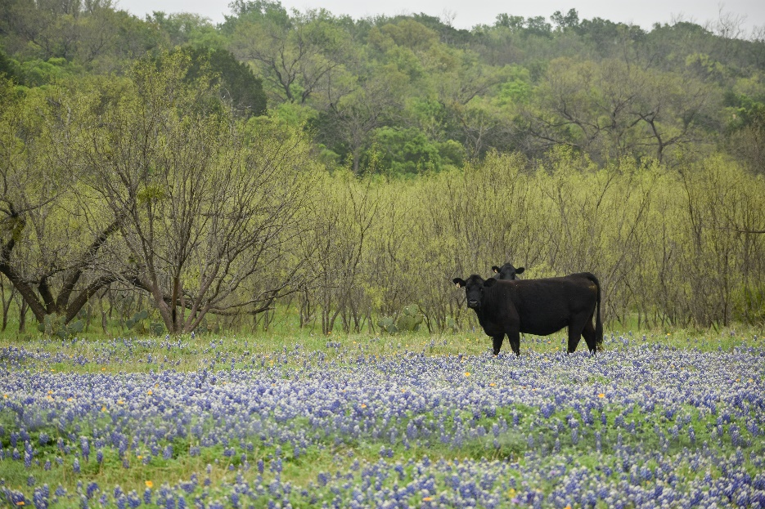
Disclaimer
This presentation is for educational purposes only as well as to give general information and a general understanding of the law, not to provide specific legal advice. This presentation does not create an attorney/client relationship and should not be used as a substitute for the advice of a licensed attorney.

Slide 3
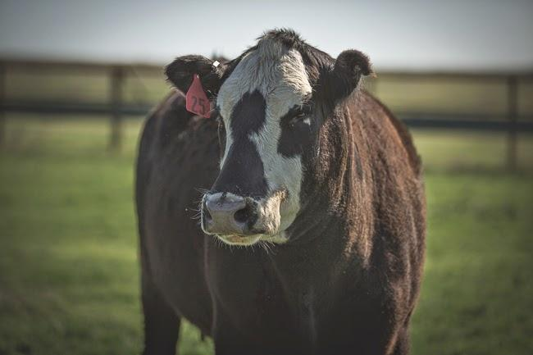
If You Have Nothing in Place…
If you die without a will, the government will determine where your assets go.
The likelihood of disputes among heirs increases.
The probate process will take longer and cost more money.

Slide 4

Steps to a Successful Transition
Create a flight plan.
Determine your goals.
Develop a business succession plan.
Develop an estate plan.
Draft & implement your plan—continue to evaluate—revise.
Adapted from: Shannon Ferrell, Oklahoma State University

Slide 5

Step 1: Create a Flight Plan

Slide 6
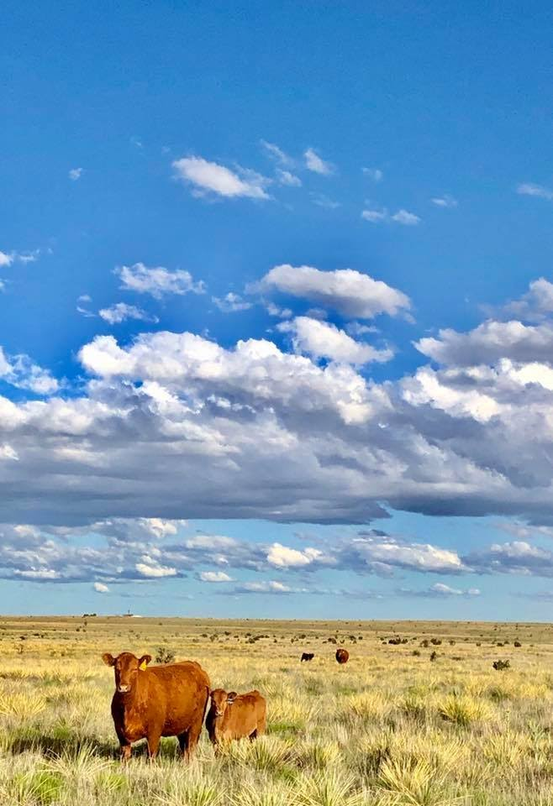
Flight Plan Contents
Estate planning documents
IRA/401(k)/Pension/Retirement Plan
Life insurance policies
Bank account info
Safety deposit box info
Debt info and pay schedules
Health insurance policies
Burial plot location and funeral instructions

Slide 7
Flight Plan Contents (cont.)
Email and computer passwords
Deeds, titles, registrations, leases, royalty documents, water permits, surveys
Birth certificate, marriage licenses, social security cards, military discharge papers
List of personal property, farm assets (structures, equipment, vehicles, land, livestock)
Crop insurance policies and FSA contracts
List of business relationships (attorney, accountant, banker, insurance agent, investment manager, livestock buyers or haulers)

Slide 8

The Gun Safe Lesson

Slide 9
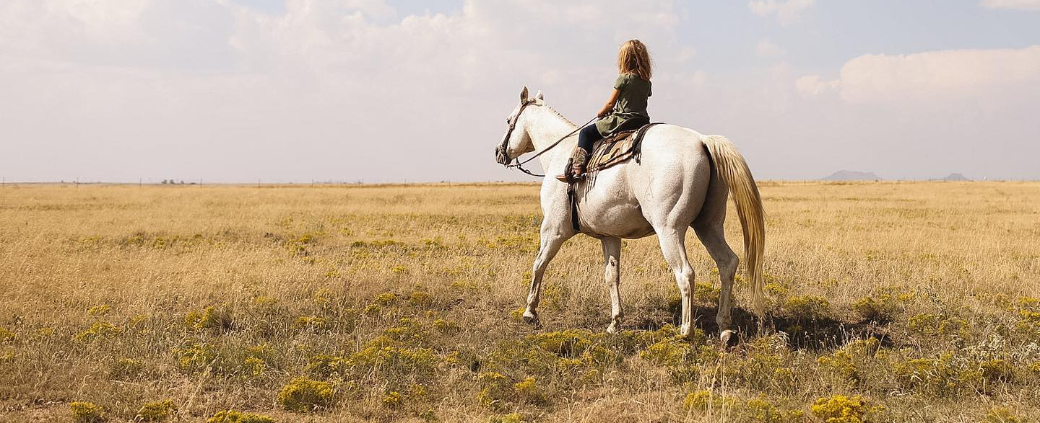
Step 2: Determine Your Goals

Slide 10
The Family Meeting
I don’t recommend the Uncle Fred approach.
Include all stakeholders.
Determine interests, values, goals, willingness and ability to participate in ongoing business operation.
Consider the best time to do this and know it may be ongoing.
There are family communications specialists and mediators that could be options.

Slide 11
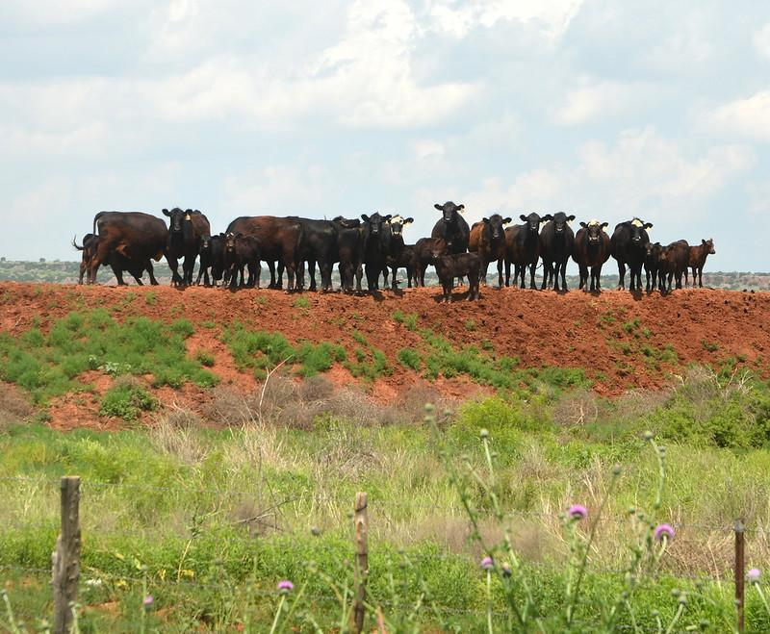
What Is Your Most Important Goal?
Common goals:
  Keep the land in the family
  Divide everything equally between the kids
    Almost never best plan for undivided interests
  Keep the land in farming
  Keep the greedy daughter-in-law’s hands off the place
  Be sure our kids are still talking at the end of this
  Determine how to equitably divide the farm if
  you have on- and off-farm heirs
  Do not lose everything we have worked for to taxes
  Ensure that mom and dad qualify for Medicaid

Slide 12
Step 3: Design a Business Succession Plan

Slide 13
Questions to Consider
How will we ensure the operation continues?
Identify who will be involved in all aspects.
How will new roles be created/existing roles changed?
What type of training, education, experience does the next generation need?
Start training and teaching now!

Slide 14
Business Entity
Use of entities can be a useful succession planning tool.
  For example, can allow a family to plan for exit of a member, be prepared in event of divorce, slowly transfer percentage ownership, account for on/off farm heirs.
Lots to consider here as to which is right for your operation.
Lots of other considerations—pros and cons:
  Tax consequences (property taxes and income taxes)
  Payment limit consequences
  Hassle
  Limited liability

Slide 15
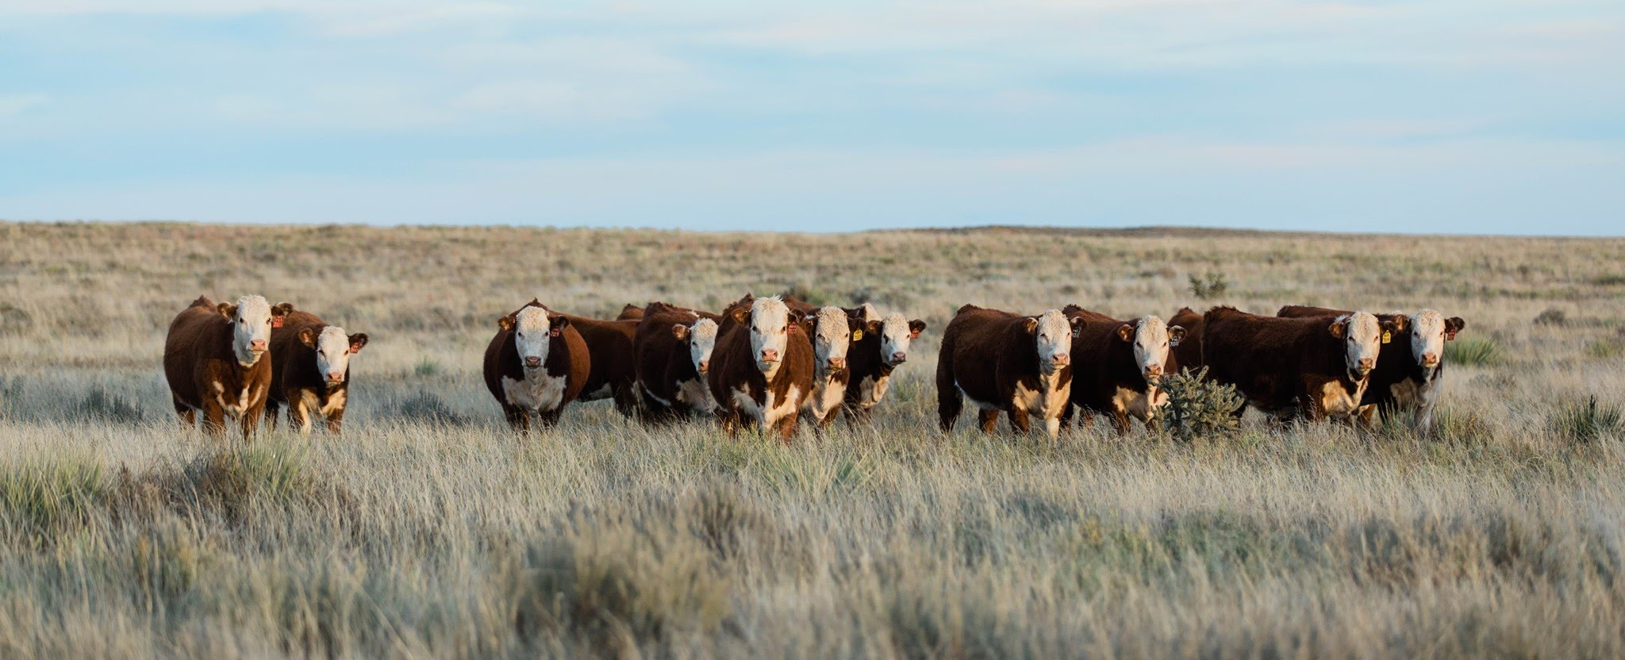
Step 4: Draft Estate Planning Documents

Slide 16
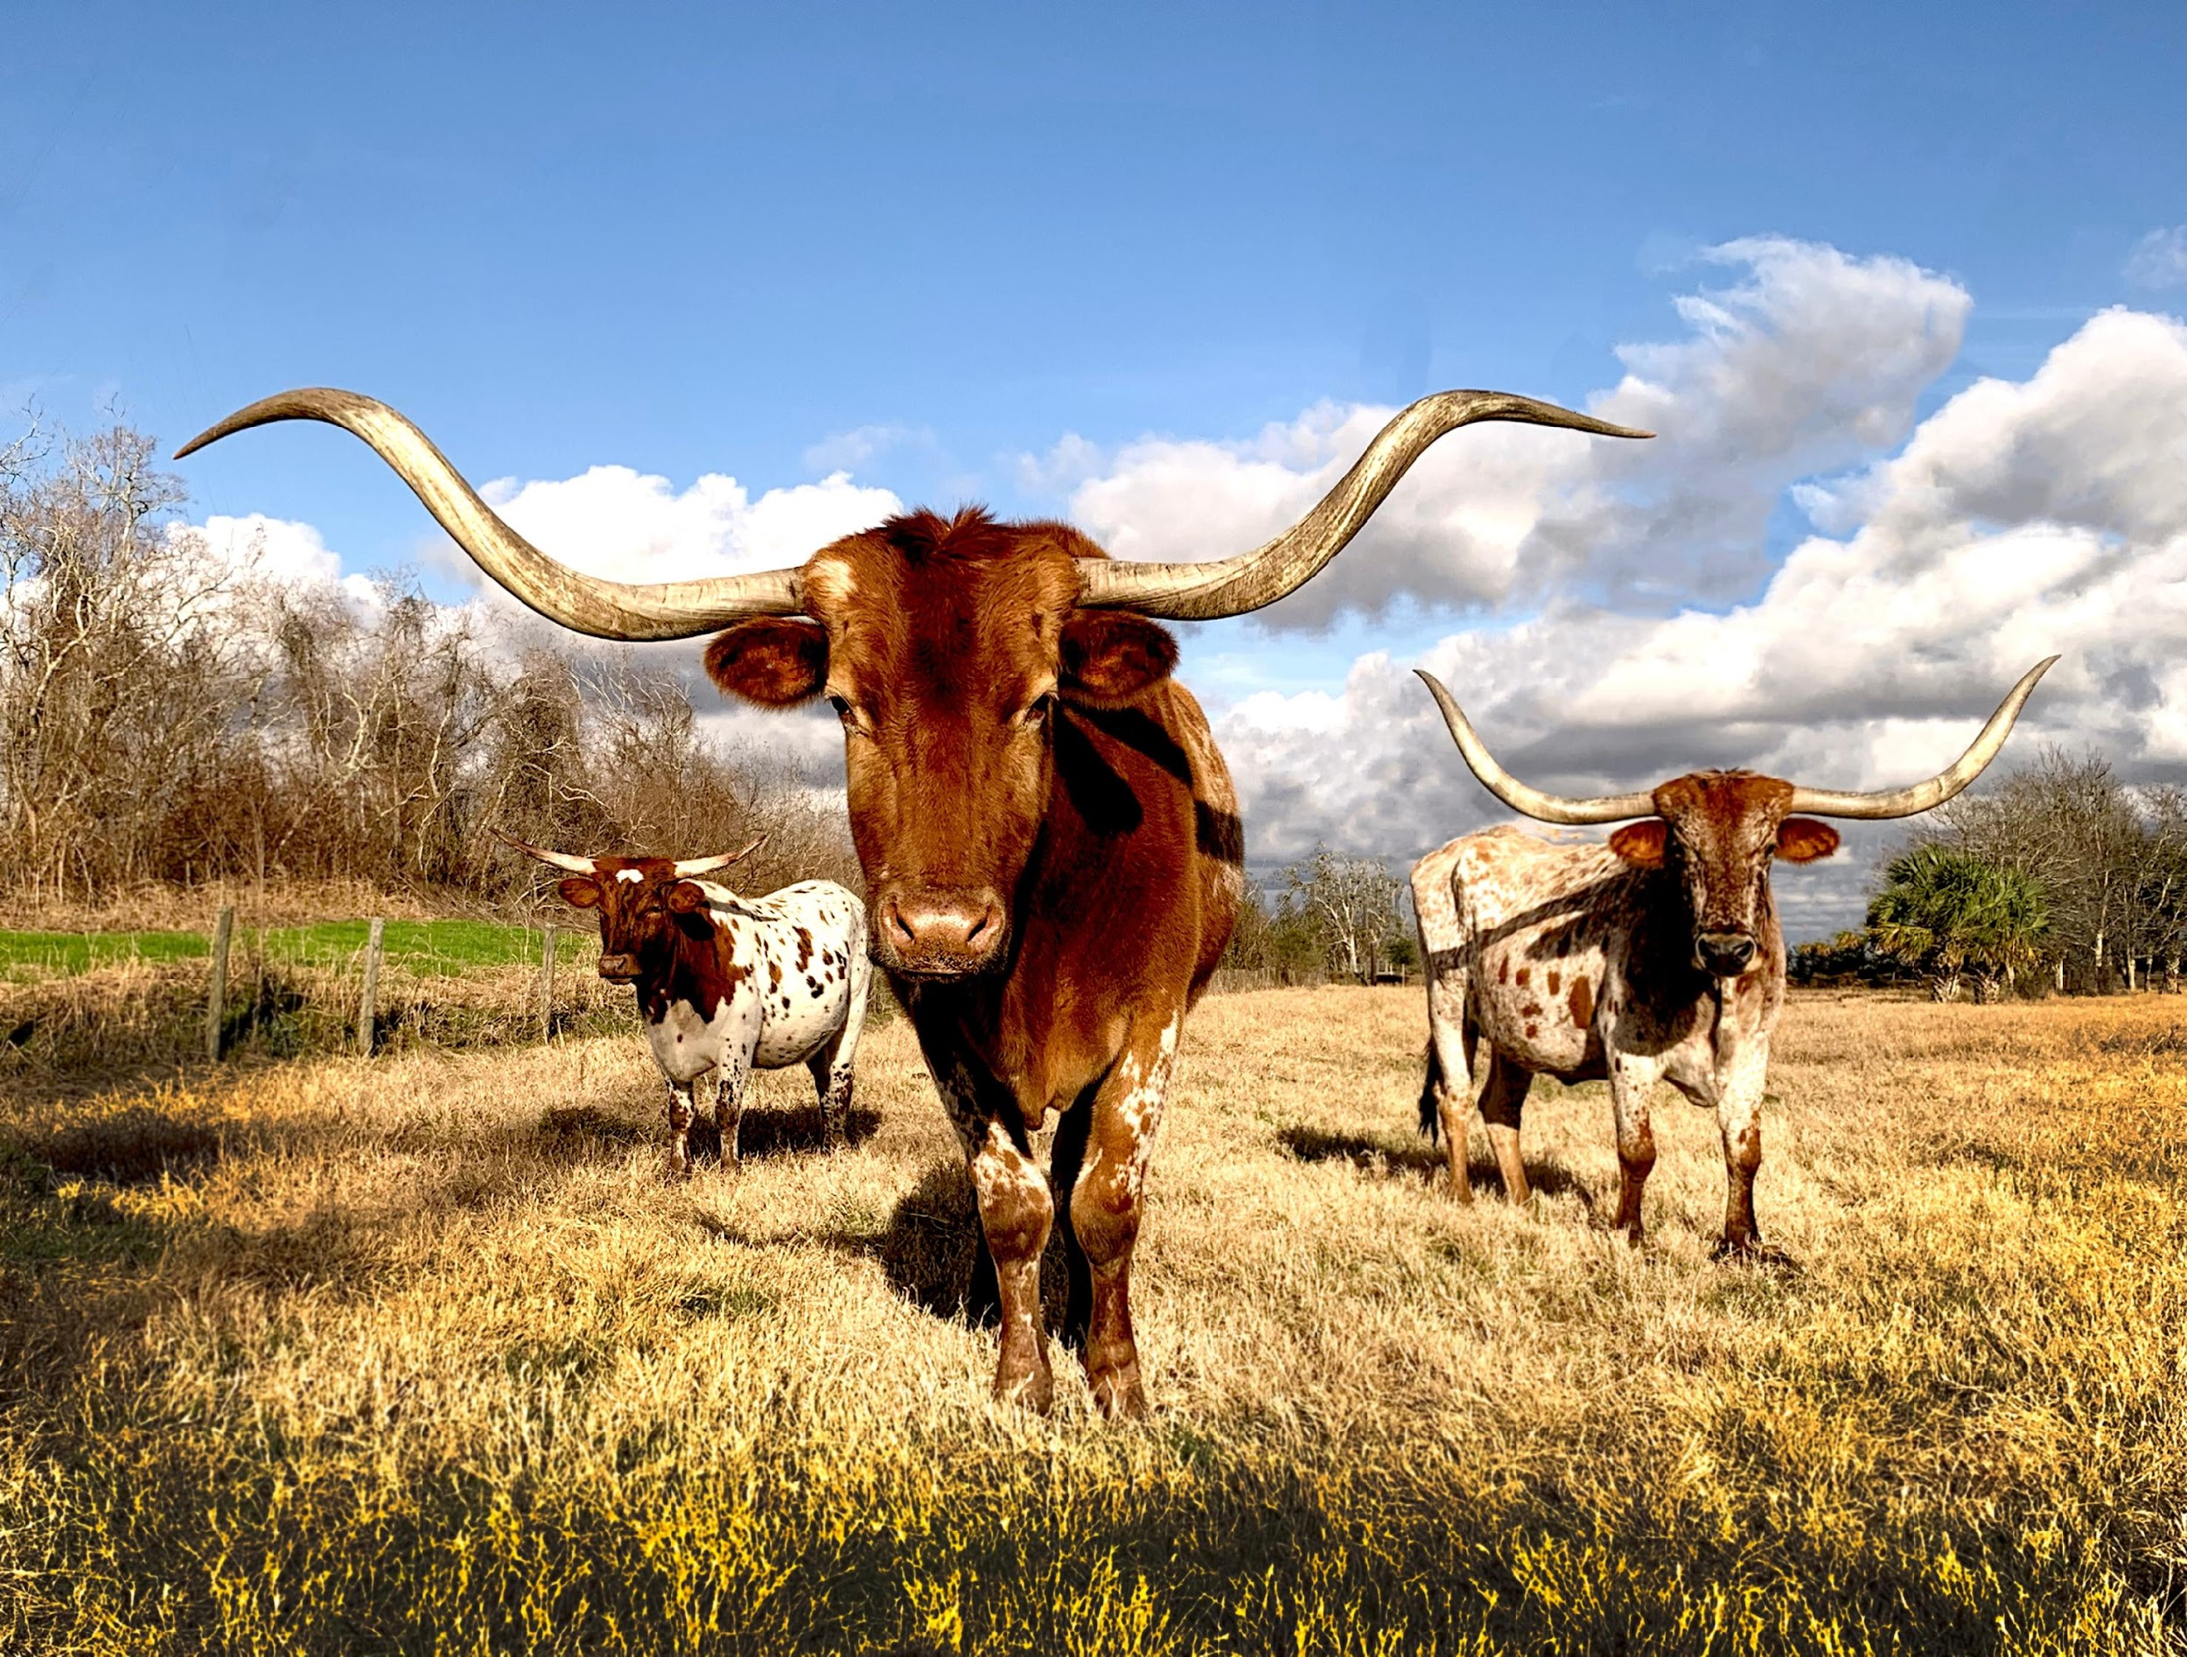
Documents Everyone Needs
Will
Durable Power of Attorney
Healthcare Power of Attorney
Advanced Directive (“Living Will”)

Slide 17

Will
Document that states how property is distributed at death.
Some assets passed by contract outside of will.
Can be handwritten or typed.
  Typed requires two witnesses to signature.
Consider self proving affidavit &
independent admin. clause
Important to revise and update
  Marriage
  Birth of children
  Death of family members
  Divorce

Slide 18
Advanced Healthcare Directive
Instruction to physician to provide or withhold artificial life sustaining procedures in the event of a terminal or irreversible condition.
Sign before 2 witnesses or notary.
Effective when diagnosed.
Give a copy to your doctor, attorney, spouse, & any appointed agent for healthcare decisions.
Statutory sample can be found online.
  Texas Health & Safety Code Section 166.033

Slide 19
Medical Power of Attorney
Allows the principal to designate an agent to make medical decisions in the event of incapacitation.
May be notarized or signed by two witnesses.
Effective when doctor certifies you are unable to make decisions.
Statutory form available online.
  Texas Health & Safety Code Sections 166.163 and 166.164.

Slide 20
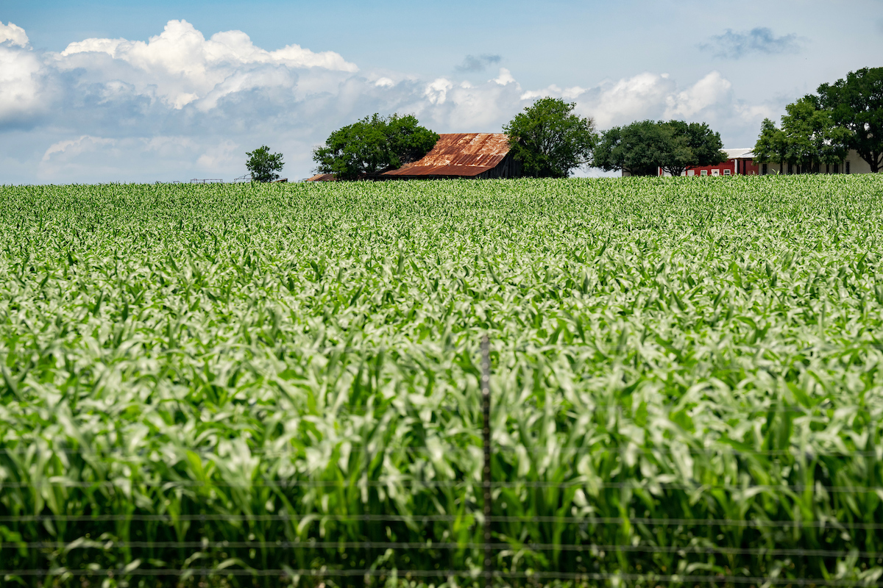
Durable Power of Attorney
Principal gives authority to agent to manage property on principal’s behalf.
Principal can select powers and include limits.
Must be notarized.
Can become effective upon signing or when incapacitation occurs.
Ends at death or appt. of guardian.
Statutory form available online
  Texas Probate Code Section 490

Slide 21
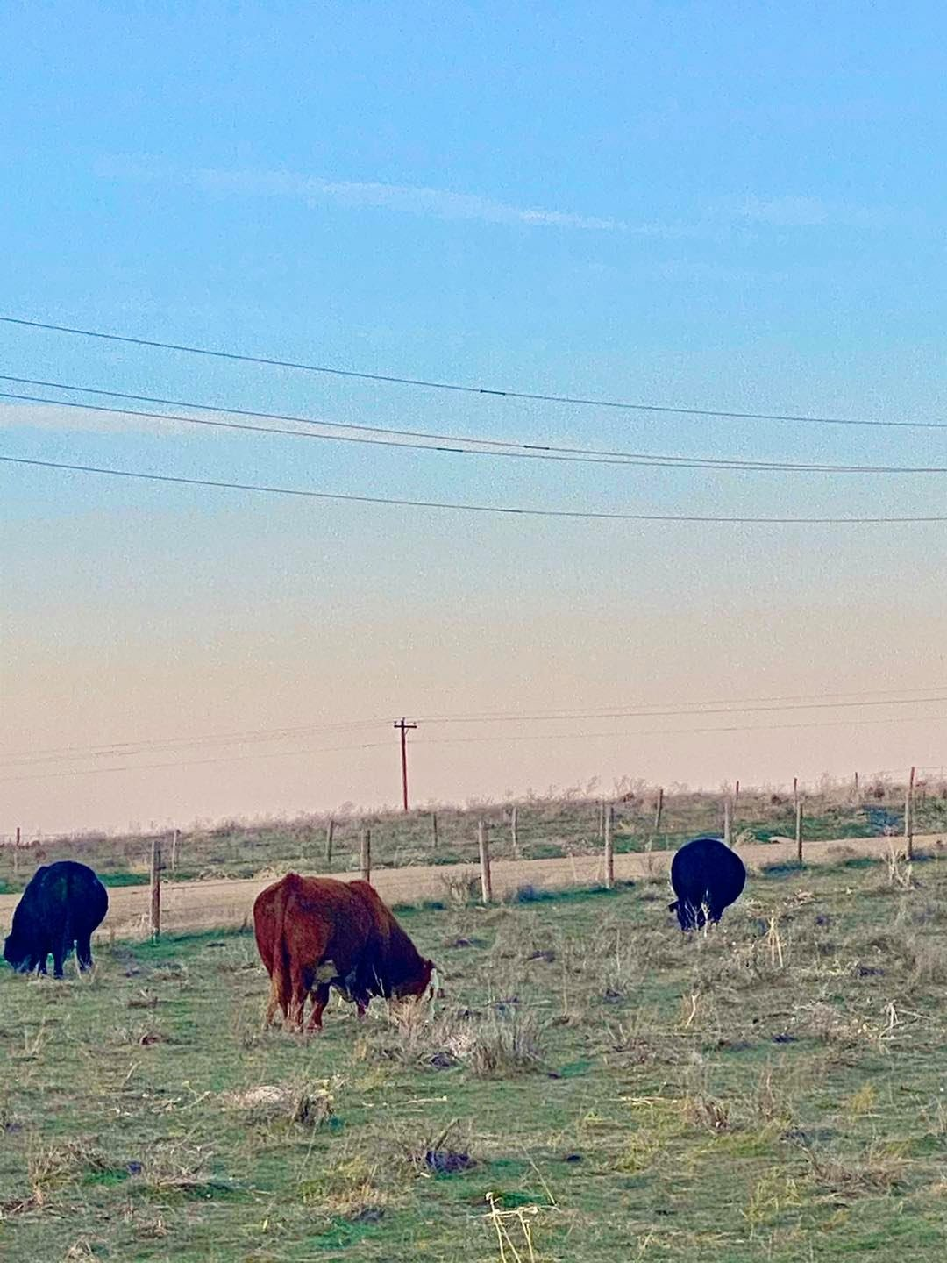
Documents You May Need
Trust
Out of hospital Do Not Resuscitate Order (DNR)
Document providing for care of dependent
(minor or special needs adult)

Slide 22
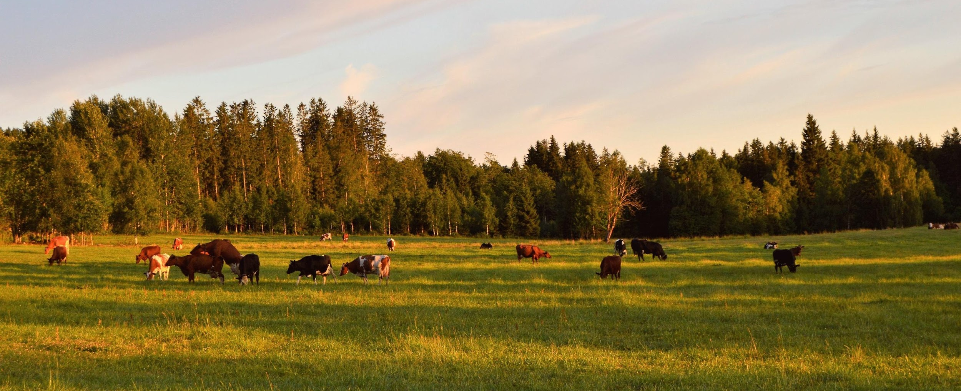
Step 5: Draft & Implement the Plan

Slide 23
Assemble the Team
Attorney
Accountant
Banker
Family

Slide 24
Continue to Evaluate and Revise
Keep talking through the plan with your family members in case there are any changes.
Yearly review of plan, documents, beneficiaries.
Review after major life events:
  Death
  Divorce
  Birth
  Purchase/sell property

Slide 25
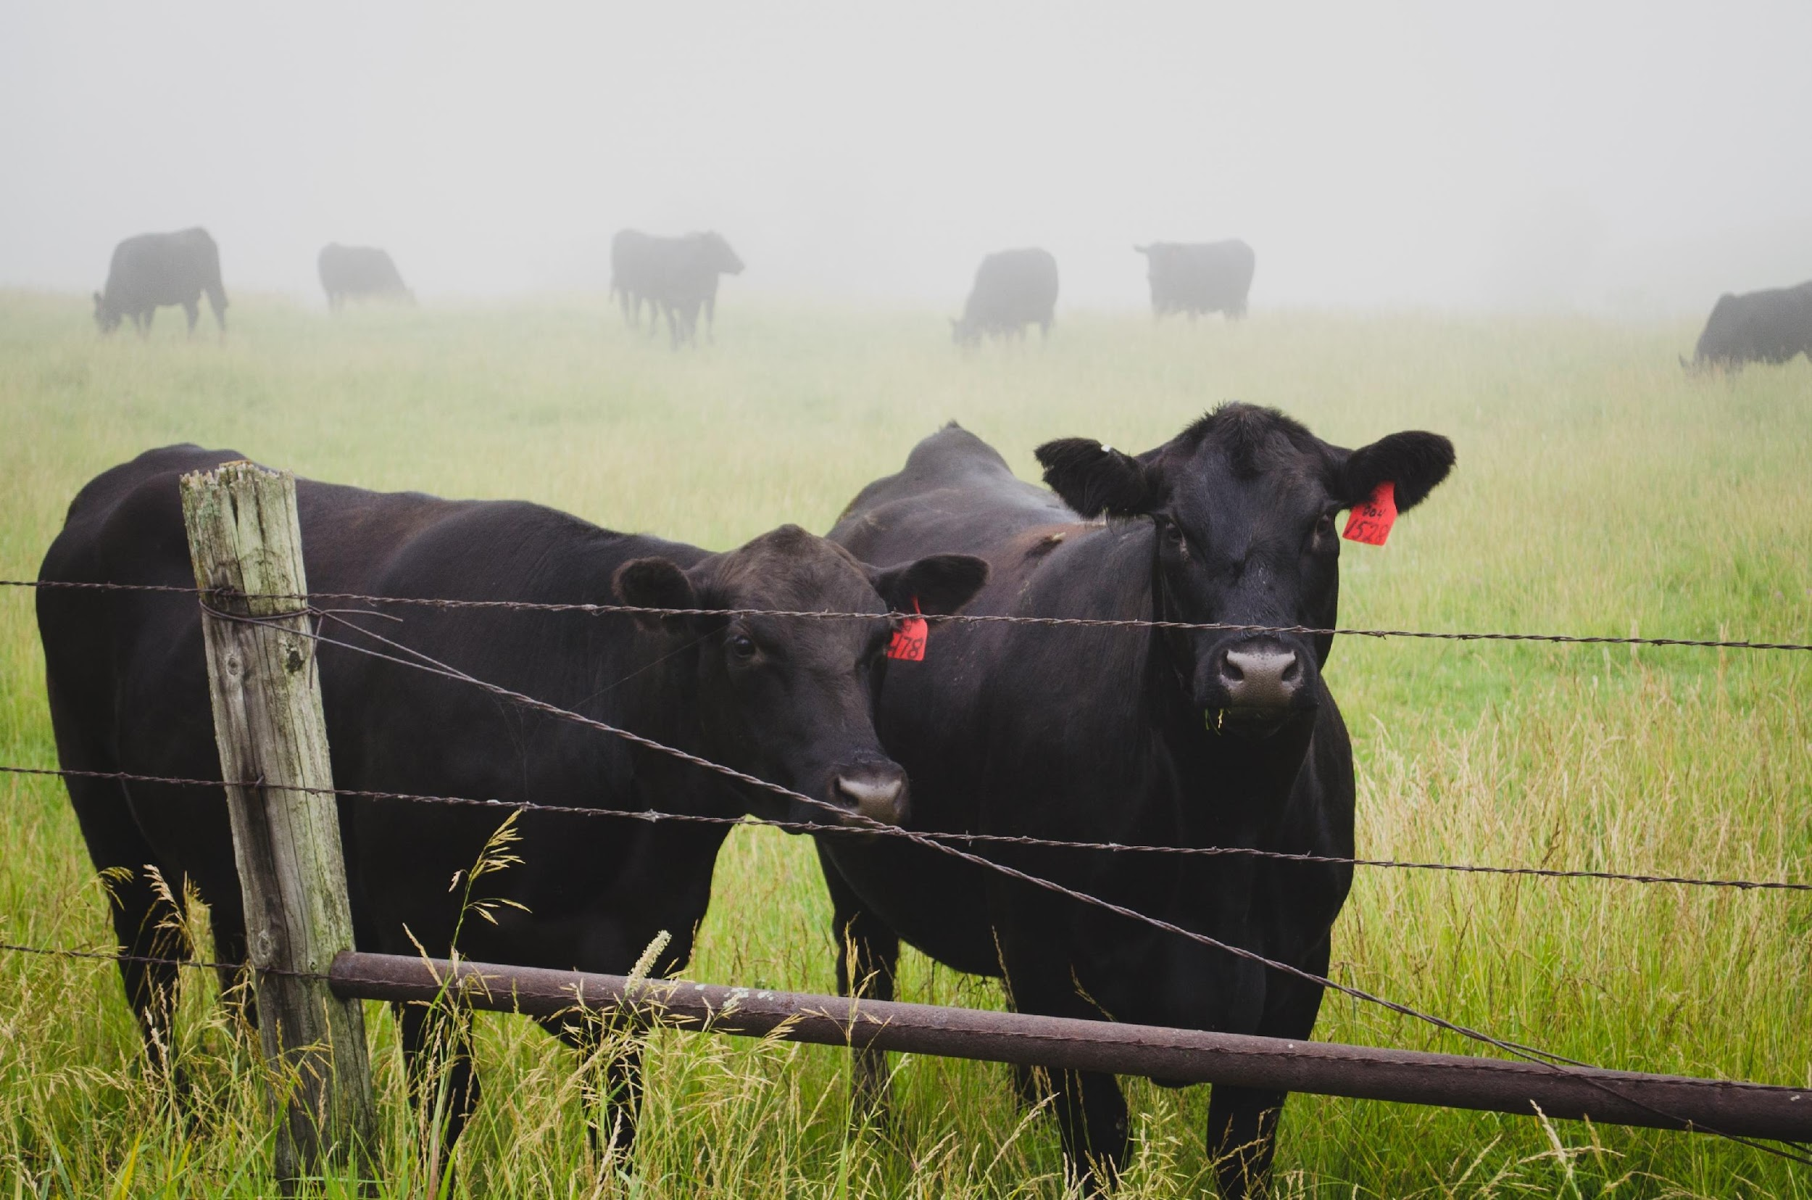
Additional Resources
Texas Corn Producers Successful Succession videos
  https://texascorn.org/growing-opportunities/successful-succession/
“Getting Your Farm & Family Affairs in Order” from the Ohio State University
  AGNR.OSU.EDU
“Farm Transitions” from Oklahoma State University
  AGECON.OKState.EDU/FarmTransitions
Farm Journal Legacy Project
  AGWEB.COM/Farm-Business/Succession-Planning
Ag Decision Maker from Iowa State University
  Extension.IAState.EDU/AGDM/WDBusiness.HTML
Annie’s Project
  AnniesProject.ORG/Resources

Slide 26
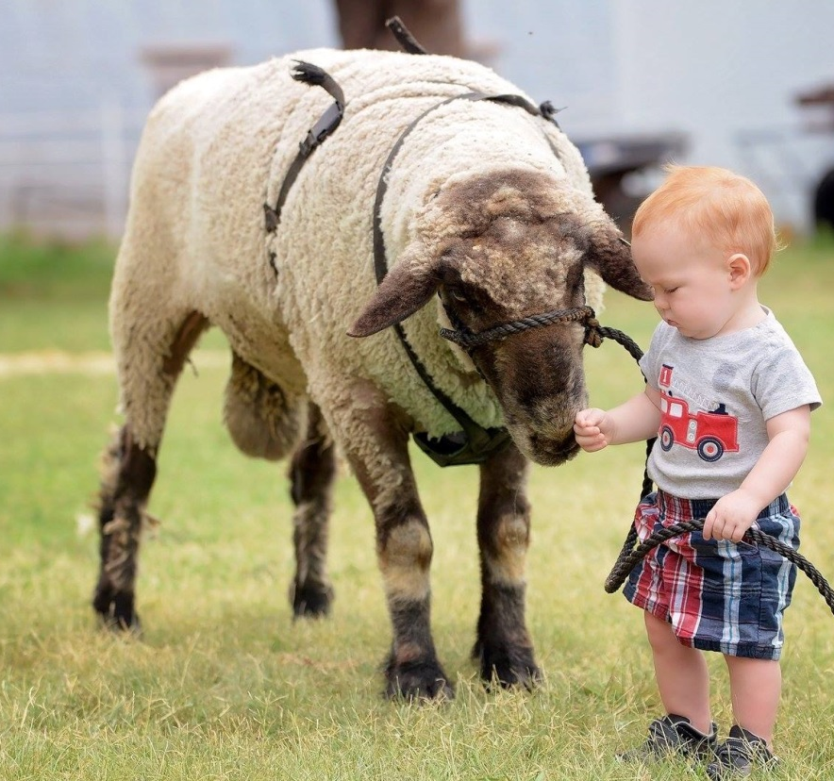
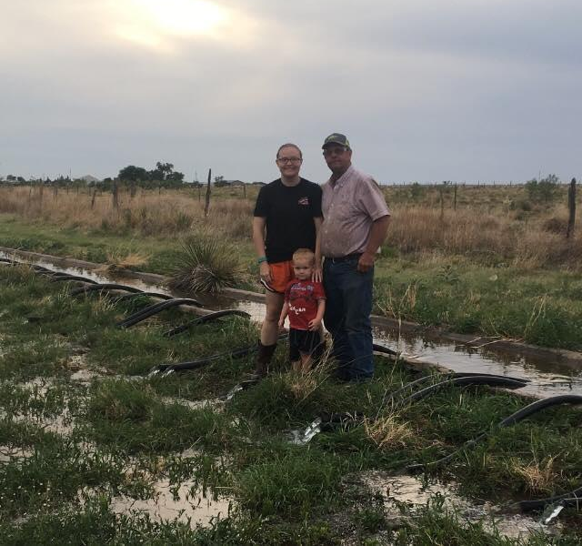
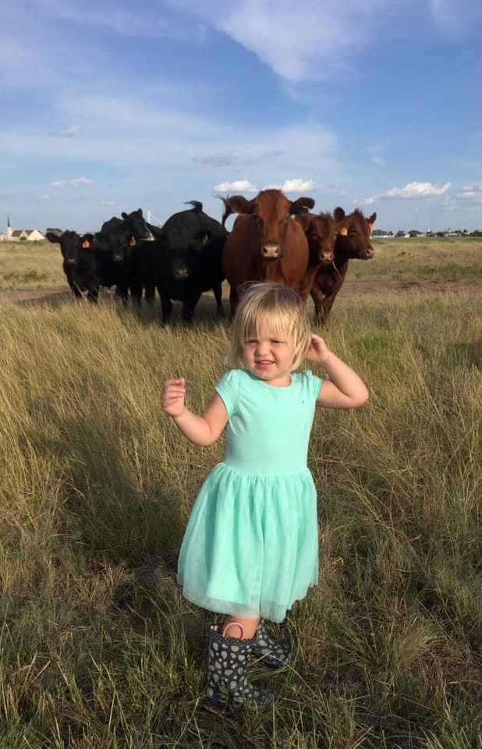
Why Go Through the Hassle?

Slide 27
Thank you!
Tiffany Dowell Lashmet
806.677.5681 | tdowell@tamu.edu
Twitter: @TiffDowell
Facebook: Texas Agriculture Law
AgriLife.org/TexasAgLaw
AgLaw.Libsyn.com
Stephanie Fryer
940.689.9175 Stephanie.Fryer@CapitalFarmCredit.com
CapitalFarmCredit.com

