Slide 1

Economic Mega Trends &
High Octane Business Strategies
Dr. David M. Kohl
Professor Emeritus, Agricultural and Applied Economics
Member of Academic Hall of Fame, College of Agriculture & Life Sciences
Virginia Tech, Blacksburg, VA
Email: sullylab@vt.edu
February 17, 2022
August 31, 2023

Slide 2

Economic Mega Trends

Slide 3

Quote for the Quarter Century
“The opportunity for business and personal prosperity is not about the size, the enterprise or the next big thing. It is about being a ‘five-percenter,’ meaning being a little better in many components of production, operational efficiency, marketing, risk management, finance, human resources and in the focus on your values and goals.”
This Photo by Unknown Author is licensed under CC BY-NC-ND

Slide 4
Farm & Ranch Business Models
Family business
  Cousins partnering with cousins
  Non-family members
  Separate enterprises/use common assets
Agri-entrepreneur
  Multi-tasker
  Gigs
  Diversified sources of income
Boomeranger professional
  “Outside the box” mindset
  New skill sets
Women, minorities, veterans
  Demographics of FFA, 4-H, MANRRS
Vertical & urban farming

Slide 5





Juggling the Triple Play
Prices
Geopolitical agendas
Manage the controllables, manage around the uncontrollables
Extreme volatility
Deglobalization
Trade policy
Sticky Inflation
Energy: oil, energy major input
Increase real estate taxes
Labor shortage vs. work ethic shortage
Interest Rates
Fastest rise since early 1980s. “Doubled in one year”
1% rise in interest rates means 200,000 fewer people qualify for home mortgages
1% rise in interest rates means 500,000 fewer people qualify for car/truck loans
Alternative investments: CDs, treasury bills

Slide 6


Triple Play Uncontrollables
Strong dollar inhibits exports, will it weaken?
Trade disruptions/geopolitics
Weather beyond the farm/fields
Energy policy, extreme volatility, fossil fuels, green movement
Inconsistency in Central Bank’s monetary/government fiscal policy
Other

Slide 7
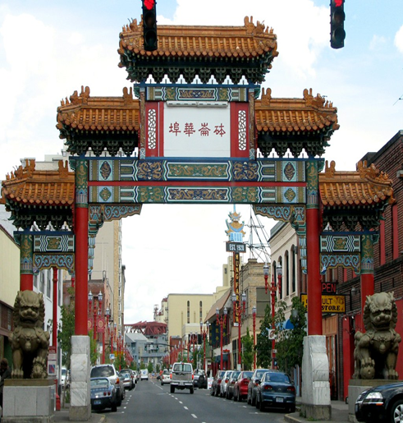

China’s Walk Around & Slow Growth 1
2nd largest economy globally
Demographic issues
  One child policy
  4-2-1 issue
  20% of 20-30 year olds unemployed
Spending issue
  Chinese citizens saved $2.4 trillion during 3 year lock down
  Uncertain future, not spending, prepaying mortgages
Manufacturing/technology
  Government enforcement of technology
  Slow export markets- U.S. & Europe
  Consumes 10-15% global oil & energy
This Photo by Unknown Author is licensed under CC BY-NC-ND

Slide 8

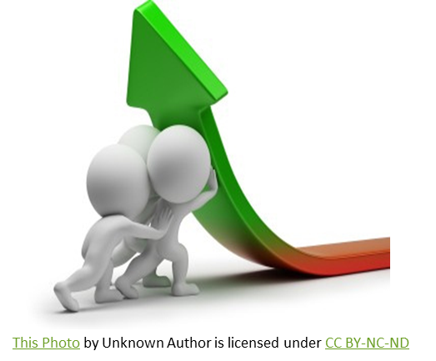
China’s Walk Around & Slow Growth 2
Debt issue
  Household debt to GDP 110%
  Housing devaluing by 25-50%
  Government spending stimulus minimal
China’s growth rate as a result of deleveraging*
  2000-2010 10.6%
  2010-2020 6.2%
  2020-2030 2-4% estimated
U.S. agriculture’s largest trading partner for cotton, soybeans, pork & milk
*Source: WSJ June 11, 2023

Slide 9
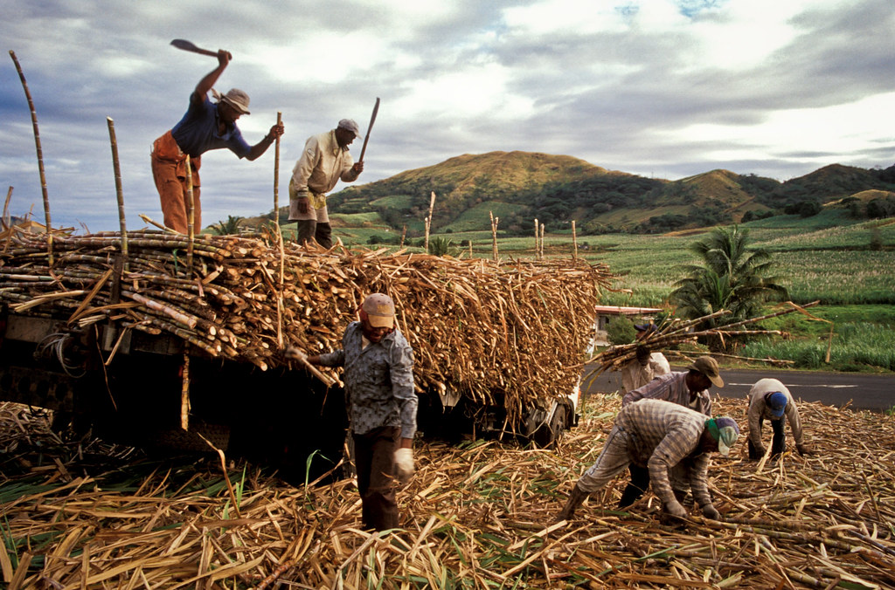
Global Walk Around - India
Surpassed China in population
  Demographic divided
Median Age: 29
5th largest economy globally
3rd largest economy by 2029
India GDP per capita $2,280
Only three-fourths of the population is literate
Females in the workforce: 23%
One-third live in cities
>55% of population are farmers and live on small family farms

Slide 10

Global Walk Around - Europe
20% of world economy
European Union & Germany are in recession last quarter 2022 & 1st quarter 2023
Growth- 1% in 2nd Qtr. 2023
Core & headline inflation above 4.5%
Increasing interest rates
Tourism boom
Russia - China trap
NATO & European unity – war in Europe
Watchlist
  Winter weather
  Climate/social changes
  Interest rates

Slide 11
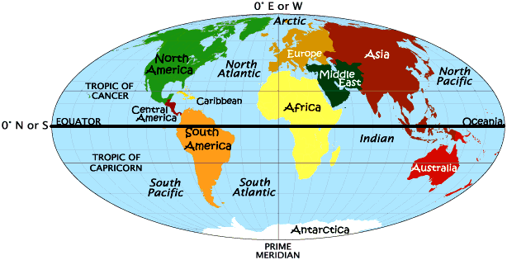
Global Walk Around - Southern Hemisphere
Brazil’s agricultural competitiveness & expansion
  Soybeans
  Corn
  Protein industry
Belt & Road Initiative
  China 2013
Alternative currency to U.S. dollar
  New Development Bank (NDB)
  Asian Infrastructure Investment Bank (AIIB)
Oceania & Southeast Asia
This Photo by Unknown Author is licensed under CC BY

Slide 12
Dollar vs New Currency
New Development BANK
Asian Infrastructure Investment Bank
Multilateral bank established by BRICS
Headquarters in Shanghai, China
Reliance on U.S. currency 2/3
Russia owns 20%- “new leader”
New expensive debt
Seeking membership from Saudi Arabia, Argentina, Honduras
Russia invasion quadrupled borrowing cost
Financed China’s Belt & Road Initiative
Infrastructure for Tomorrow
Designed to reduce dependence on dollar based funding
Alternative to IMF
Western countries are members
Source: Wall Street Journal June 16, 2023

Slide 13
Domestic & Global Disruptors (1)
China, India, Russia, Brazil, Saudi Arabia, others
  New world digital currency to challenge U.S. dollar supremacy
Fossil fuels – green energy transition
  Disjointed global effort
  Unintended consequences
  Economic competitiveness
  Black swan issues
  “If it is green, it must be in the black or profitable without government support.”

Slide 14
Domestic & Global Disruptors (2)
Artificial Intelligence (AI)
  Good, bad, ugly
  More high tech, more high touch
  Checking the brains at the door- common sense
  Artificial Intelligence (AI) & Human Intelligence Equivalents¹
    2020: AI equals Human IQ 80
    By 2022: AI is expected to equal Human IQ 100
    By 2024: AI is expected to equal Human IQ 120
    2028: AI is expected to equal Human IQ 1200!
ESG (Environmental, Social, & Governance)
Alternatives to meat, milk, & other products
¹Source: “Digital Disruption in Agriculture”- Nishan Majarian- Agrian, CEO

Slide 15

Fed Funds Rate Hikes in 2022-2023
Date | Change in Basis Points
March 17, 2022 | 25 bps
May 5, 2022 | 50 bps
June 16, 2022 | 75 bps
July 27, 2022 | 75 bps
September 21, 2022 | 75 bps
November 2, 2022 | 75 bps
December 14, 2022 | 50 bps
February 1, 2023 | 25 bps
March 22, 2023 | 25 bps
May 3, 2023 | 25 bps
June 14, 2023 | 0 bps
July 26, 2023 | 25 bps
Regional & global banking issues = 100 to 150 bps increase
Rate | Percent
Fed Funds Rate | 4.25% to 5.5%
Prime Rate | 7.25% to 8.5%
Your Rate | Depends on Risk

Slide 16
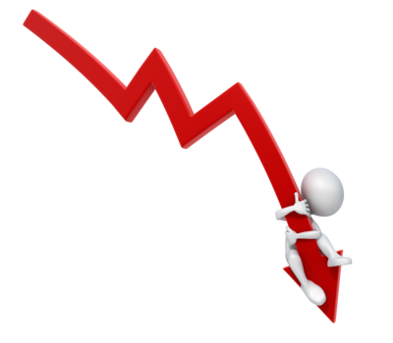
Factors for Interest Rate Decline
Inflation
  Headline 4.0%
  Core 2.0%
Unemployment
  U-3: 4.5%
  U-6: 7.5%
Two quarters of negative GDP
Yield curve – flat to positive

Slide 17

R-star: The Natural Rate of Interest
R* is the short term interest rate that would exist when inflation and unemployment are at levels that do not stimulate or restrain the economy.
  2.25% to 3.25% Fed funds rate
  5.25% to 6.25% Prime rate
  Days of zero-bound interest rates (2008-2020) are in the rear view mirror.
  Fiscal policy has an instantaneous impact with checks in the mail
  Monetary policy (Fed action) has a lag effect of 8 to 18 months

Slide 18

History of Land Values
1910-2022 Perspectives on “Booms”
Large appreciation: WWI, WWII, Korean War, 1970s
Yearly appreciation peaked > 20% annually
Strongest sustainable growth was the 1970s decade which saw > than 10% growth about 70% of the time
Rule of 79 since 1910
Rule of 88 since beginning of WWII

Slide 19

History of Land Values
1910-2022 Perspectives on “Busts”
In the 1920s, land values declined 5% to 10% annually
In the early 1930s during the Great Depression, land values declined 10% to 20% annually
In the 1980s, land values declined 5% to 10% annually for five years
In 2009 during the Great Recession, farm land values declined 5% annually
Other declines nationally: 1% to 3% annually for 1 year

Slide 20
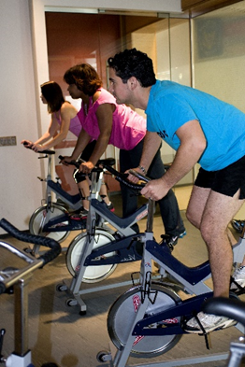


Eight Habits of Parents/Grandparents
Rule of 78: Quality of Life
Physical
Mental
Drink water
Exercise regularly
Healthy diet
Sleep
Support network
Life purpose
Mental activities: read, meditate
Faith & spiritual

Slide 21

Farmland Investment Filter
Understanding of short & long term goals
Debt financed vs. cash purchase
Working capital to expenses >20% post purchase
Current ratio > 1.5:1 post purchase
Term debt to EBITDA < 5:1
Purchase of farmland is a marathon, not a sprint
Can you survive a 3 to 5 year downturn?
High business IQ >32
Modest family living / off farm revenue

Slide 22

Future Economic Mega Trends
Cryptocurrency
Pig heart & kidney transplanted into human
Alpha-gal syndrome (tick induced allergy)
A2A2 milk
Plant based proteins
Electric vehicles
Technology: Pearl Harbor 911 just around the corner
Carbon payments
Rural renaissance

Slide 23

High Octane Business Strategies

Slide 24
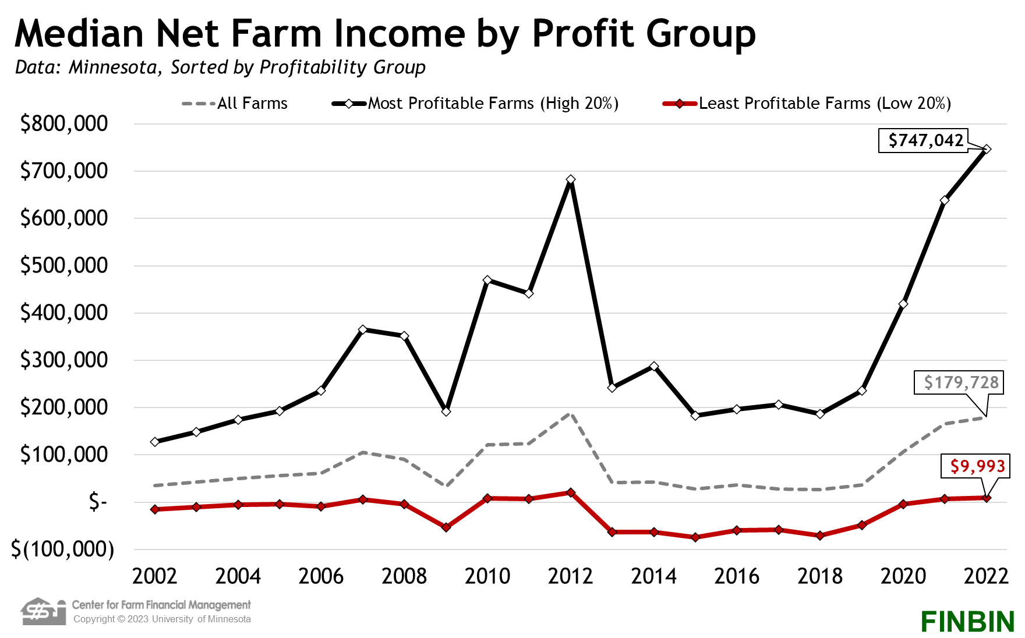

Slide 25

High Octane Business Strategies:
The Seven P’s
Planning – Manage the Controllables and Manage Around the Uncontrollables
  Plan, strategize, execute, & monitor
  HUT principle
  Team of advisors to energize the process
  5 to 10% of the time
  Written business plan – 4X’s more profitable
  Mental health twice as strong
  Just in time vs. just enough – Plan for A, B, C, & D
“Failing to prepare, is preparing to fail.”
- John Wooden, UCLA Coach

Slide 26
Business IQ: Management Factors
Critical Questions for Crucial Conversations

Slide 27
Business IQ Exercise
After completing the Business IQ: Management Factors Scorecard, what are three areas/points in your business that you will continue and three areas/points for improvement?
Three areas/points to continue:
______________________
______________________
______________________
Three areas/points to improve:
______________________
______________________
______________________

Slide 28
Business IQ: Top Third vs. Low Third
Ratio | Top 1/3* | Bottom 1/3*
Debt/Total Asset | 20.52% | 50.08%
Return on Assets | 3.16% | 0.173%
Net Farm Income | $202,120 | $53,406
Coverage Ratio | 114% | 10%
Operating Expense to Revenue Ratio (excluding interest & depreciation) | 68% | 90%
* Mean
Source: Preliminary Study of Kentucky Farm Business Management Association data - Ben Isaacs, Undergraduate Research Study at University of Kentucky

Slide 29

High Octane Business Strategies:
The Seven P’s
Proactive Goal Setting
  80-16-4 Rule
  Six degrees of goal setting
  Short term- 1 year or less
  Long term- 3-5 years
  Goals should be S.M.A.R.T.
  Business, family & personal
  Mental, physical & spiritual
  20% of top producers have written goals
  Developing written goals: earn 4 times as much in lifetime
“Goals provide focus in a cluttered world.”

Slide 30
High Octane Business Strategies:
The Seven P’s
Pivot: Block Adversity/Capitalize on Opportunity
    Working capital & quickness to cash
    Working capital/debt service (principal & interest) >5 to 1
    Working capital/expenses >25%
      >30% of your working capital - able to be converted to cash in 90 days
    Four to eight months of household expenses in cash
    Financial liquidity & cash: the bridge
      Shock absorber- cash flow, profits
      Preserve wealth or liquidity fallback
“Cash is queen on a chessboard”.

Slide 31

Bridge & Pier Concept
Are you building a bridge or a pier?
Refinance #3
The more you go down the pier, the deeper the water. This increases the need for a higher level of expertise, and there are fewer options.
Refinance #2
Refinance #1

Slide 32
High Octane Business Strategies:
The Seven P’s
Projected Cash Flow (Financial Sensitivity Analysis)
  Best, average & worst case scenarios “best of the best”
  Monitor more than annually- “variance analysis”
  10-10-5 financial sensitivity
  Cash flow & financial sensitivity analysis
  are the “financial guardrails”.

Slide 33
Family Living Summary 2005-2014
Source: Nebraska Farm Business, Inc. www.nfbi.net

Slide 34
Family Living Summary 2015-2022
Source: Nebraska Farm Business, Inc. www.nfbi.net

Slide 35
High Octane Business Strategies:
The Seven P’s
Profitability
  60-30-10 profit plan
  Term Debt to EBITDA
    <3:1 Green (moderate agility/resiliency)
    3:1 to 6:1 Yellow (some resiliency, little agility)
    >6:1 Red (low agility/resiliency)
  Earns & turns
    Margin X capital turnover = ROA
“Profit is the oxygen of the business.”

Slide 36
High Octane Business Strategies:
The Seven P’s
Pathway – the Journey/Transition Management
    Wonder, blunder, thunder, & under phases
    1% asset or equity base invested in transition planning
    50% retirement income for senior generation
    Personal budget & business budgets
    Invest 5% of income outside the business

Slide 37
High Octane Business Strategies:
The Seven P’s
People - Independent vs. Interdependent
  Productive people is the difference between good and great
  Good to Great: Why Some Companies Make the Leap... and Others Don’t by Jim Collins
  Six perspectives of the bus
  Accountability: leadership, frontline people, family members, advisors
  Role players win championships

Slide 38
High Octane Business Strategies:
The Seven P’s
Prioritization of Priorities
Overscheduled- work & life balance
Goal setting- six degrees
2,500 - 500 hour rule
MEDS for life:
  Meditation
  Exercise
  Diet
  Sleep & Support network
DAIRY for life:
  Discipline
  Attitude and Accountability
  Initiative, passion and zest
  Respectful, Reliable and open to Reason
  You - It’s all up to You. “Look in the mirror.”

Slide 39

Game Plan Actions for 2024
Game Plan Action- Check Status | Yes | In Progress | No
Develop your goals- business, family, & personal Short run Long run | □ □ | □ □ | □ □
Complete the Business IQ | □ | □ | □
Develop a business & personal balance sheet | □ | □ | □
Develop projected cash flow | □ | □ | □
Develop a written yearly operational plan | □  | □ | □

Slide 40

Q&A with Dr. Kohl

Slide 41

Extra Insights!
This Photo by Unknown Author is licensed under CC BY-SA-NC

Slide 42
The Feisty Fifteen:
Problems Your Business Should Have (1)
Your business pays lots of taxes.
  find sweet spot of paying taxes vs. deductions
Your lender wants to loan you money.
  strong profits/cash flow
  war chest for working capital - greater than 25% of operating expenses
You have growth frustrations, just can’t grow fast enough.
  overestimate capital and time by 25%
  term debt to EBITDA < 5 to 1
  working capital to debt service > 5 to 1
  human horsepower & management acumen
Everyone wants to work for you.
  attract & retain the right people, including family members
  be a work culture magnet
  over compensate productive people

Slide 43
The Feisty Fifteen:
Problems Your Business Should Have (2)
Your business has excess cash sitting around.
  cash is queen
  blocking capital in adversity
  opportunity capital for purchases or acquisitions
In a family business, the older generation suddenly wants to exit, and they have at least 50% of retirement income generated outside the business.
You have time for family & friends when neighboring businesses don’t.
  2,500/500 hour rule
You could walk away from the business for one month and it functions fine without you.
You left money on the table when marketing this year’s crop or livestock.
The younger generation spends too much time in the office on the computer and in the books.
You must spend money for a facilitator and team of advisors for your transition/estate plan.

Slide 44
Two Business Turnarounds - The Rest of the Story…
Weekly & monthly cash flow projections & monitoring
Mini victories ripple through the organization
Get better before you get bigger
  Enterprise analysis
  KISS (Simplify, simplify, simplify!)
  Duplication of the processes
Toxic people = toxic environment
Capital, expertise bridge & commitment
Three actions of being a five percenter
Board member from outside the industry
Best, average, worst case financial scenarios – financial guardrails
Best of the best scenario for internal challenge
80% of business is existing customers (Keep the fox out of the hen house!)
Low hanging fruit – new markets, pricing strategy, ahead of inflation
Relationship lender with expertise
What Got Us Here Won’t Get Us There!

Slide 45
Dr. David Kohl’s
Contact Information:
Online Articles:
Road Warrior of Agriculture
  https://www.farmprogress.com/road-warrior
Ag Globe Trotter
  https://agwestfc.com/education-and-resources/industry-and-economic-insights/economic-updates/agricultural-trends
Dave’s GPS & Dashboard Indicators
  https://www.farmermac.com/news-events/daves-gps/
Office:
(540) 961-2094
Alicia Morris
Scheduling:
(540) 493-2724
Angela Meadows
Email:
sullylab@vt.edu

