Slide 1
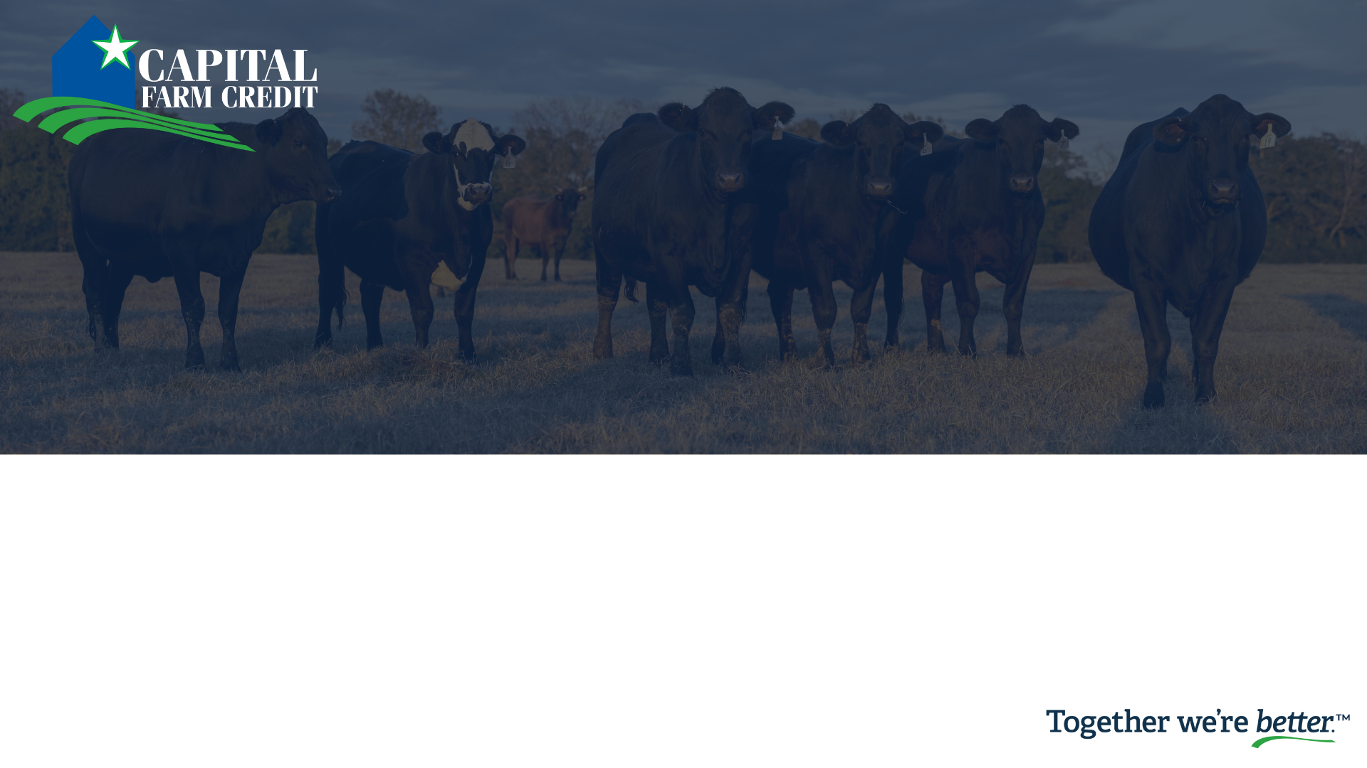
Insurance Services
Greg Lance & Cary Franks

Slide 2

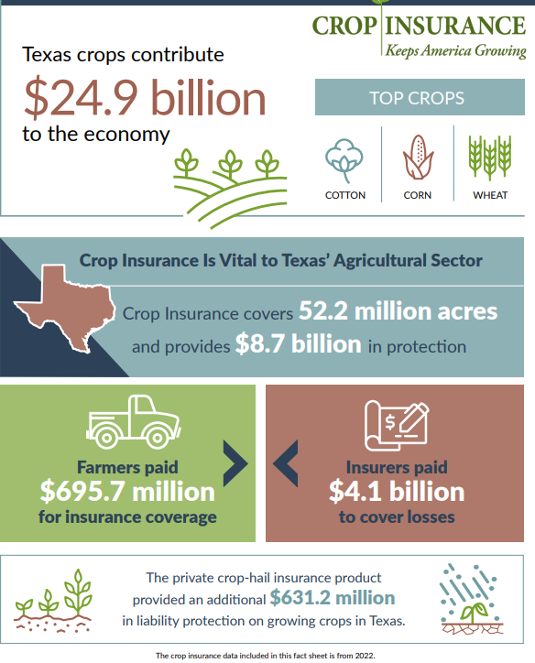
Source: Crop Insurance in America
Notes:
Why crop insurance is important---
Agriculture drives Texas’ economy and crop insurance is vital to the Texas Agriculture sector

Slide 3

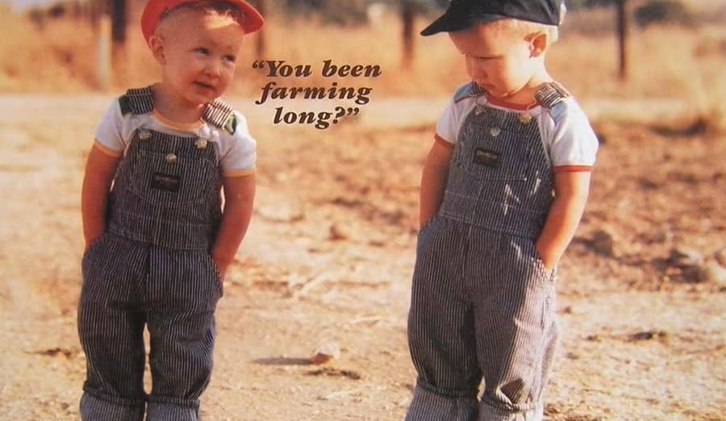
You hear Capital Farm Credit has Crop Insurance?
Nope, when did that happen?

Slide 4
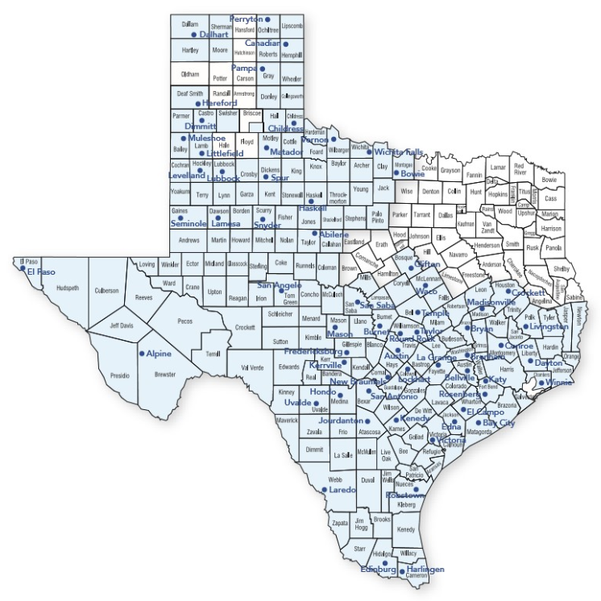
Insurance Services
Experienced Agent Team
Experienced Administrative Team
Ability to write policies in several states

Slide 5



Insurance Services
Insurance Providers Where We Place Business:
  RCIS – Owned By Zurich Insurance Group
  A.M. Best Rating – A+
  Great American Insurance Group
  A.M. Best Rating – A+
  AgriSompo
  A.M. Best Rating – A+
Notes:
There are 14 AIPs in the United States.
AgriSompo is the Third Largest AIP
Zurich Insurance Group is the Fourth Largest AIP
Great American Insurance Group is the Fifth Largest AIP

Slide 6
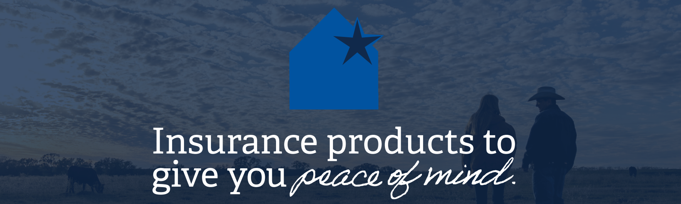
Our Mission
To be the best at delivering crop and livestock insurance solutions
  Professional Agent and Administrative Staff
  Leveraging Capital Farm Credit’s resources
  Partnering with the strongest Insurance Companies

Slide 7
Insurance Options
Crop Insurance:
  Multi-Peril (MPCI)
  Crop Hail
  Crop Fire
Livestock Insurance:
  Pasture, Rangeland and Forage (PRF)
  Annual Forage
  Livestock Risk Protection (LRP)
  Livestock Gross Margin (LGM)
  Dairy Revenue Protection (DRP)

Slide 8

Crop Insurance Options

Slide 9
Multi-Peril Crop Insurance (MPCI)
Insurance available for over 120 crops
Subsidized Premium – Must be in Compliance (AD-1026 on File)
Beginning Farmers and Ranchers (5 Years or Less) – Additional 10% Subsidy
Coverage options include, but not limited to, yield and price protection guarding farmers against potential loss in revenue from low yields or changes in market price
Spring Sales Deadline: January 31 - March 15 (depending on area)
Fall Sales Deadline: September 30th

Slide 10
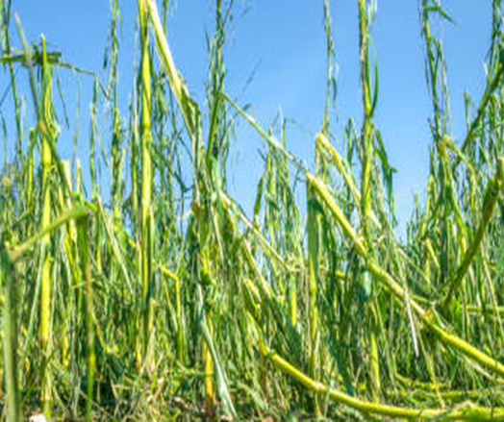
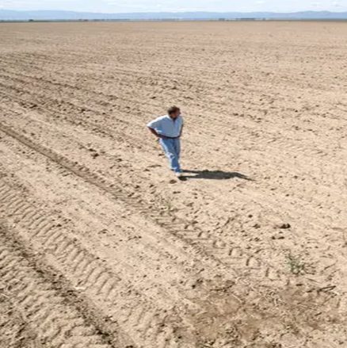
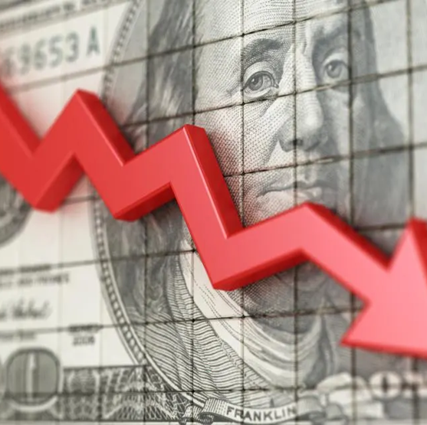
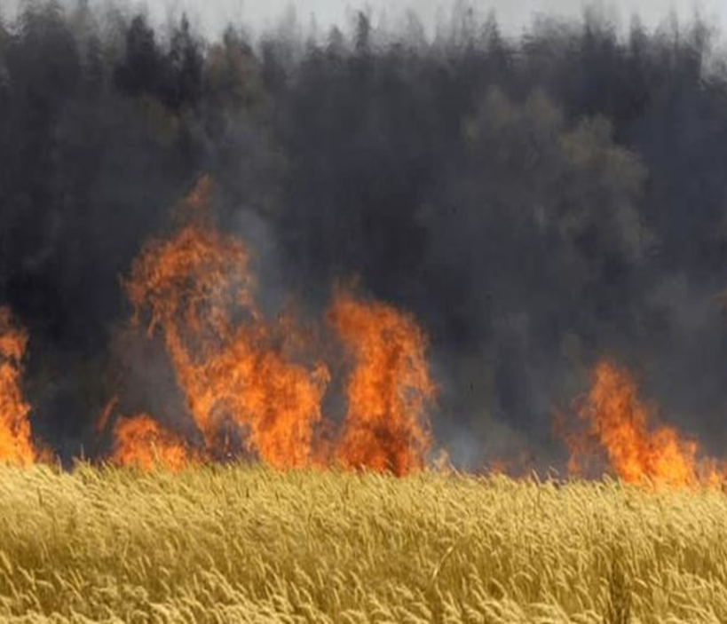
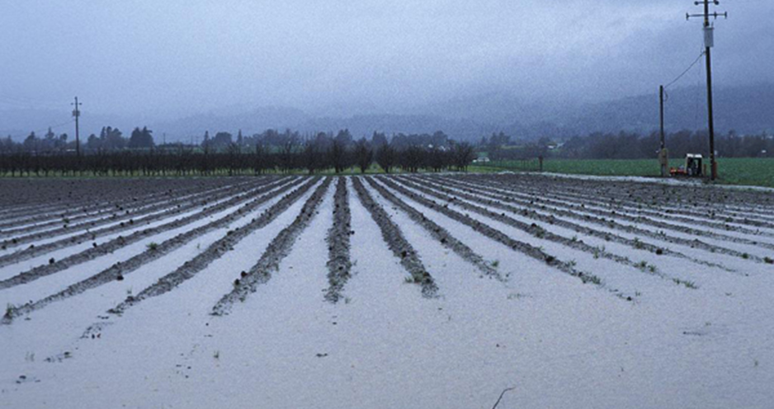
Multi-Peril Covered Perils:
Adverse Weather Conditions
Fire
Insects
Plant Disease
Wildlife
Earthquake
Volcanic Eruption
Failure of Irrigation Water Supply
Market Price Changes (Revenue Protection)

Slide 11
Crop Hail Insurance
Protects against physical damage caused by hail and/or fire
Policies provided directly to farmers by private insurance companies
Can be used in combination with MPCI coverage or separately
Claims paid on acre-by-acre basis
Sales Deadline: Anytime during the growing season

Slide 12
Crop Fire Insurance
Extra coverage for direct crop loss caused by fire or lightening
Covers crops before harvest and while still in the harvester
Policies provided directly to farmers by private insurance companies
Sales Deadline: Anytime during the growing season

Slide 13
Livestock Insurance Options

Slide 14
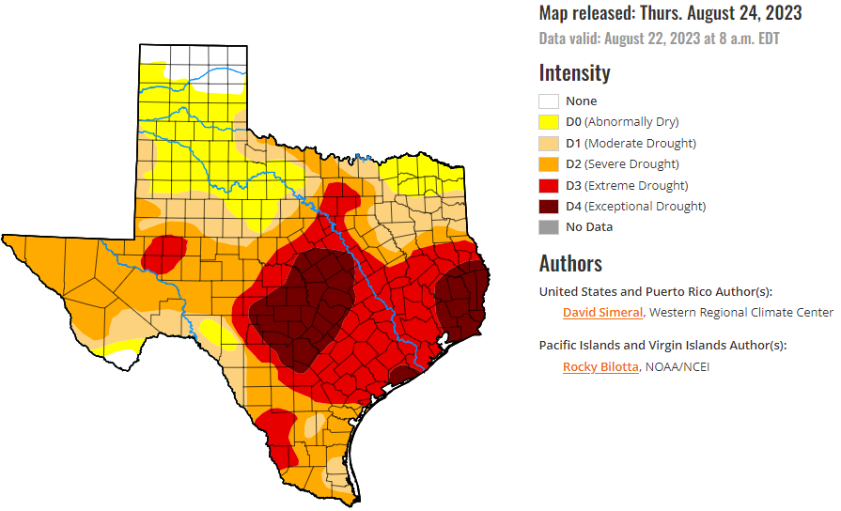
Drought Monitor

Slide 15
Pasture, Rangeland, & Forage (PRF)
Protects hay and livestock producers against loss of forage, due to lack of rainfall, on acres used for grazing and hay.
Choose between two to six 2-month intervals in which precipitation is important to the operation.
Many ranchers can qualify: no yields needed, based off acres (no minimums).
Sales Deadline: December 1st

Slide 16
Pasture, Rangeland, & Forage (PRF)
The rainfall index uses National Oceanic and Atmospheric Administration Climate Prediction Center (NOAA CPC) data for the grid where the property is located.
Insurance payments are determined using NOAA CPC data for the grids and index intervals you choose to insure. When the final grid index falls below your "trigger grid index," you may receive an indemnity for lack of precipitation.
Coverage is based on the experience of the entire grid – not on an individual farm or ranch or a specific weather station in the general area.

Slide 17
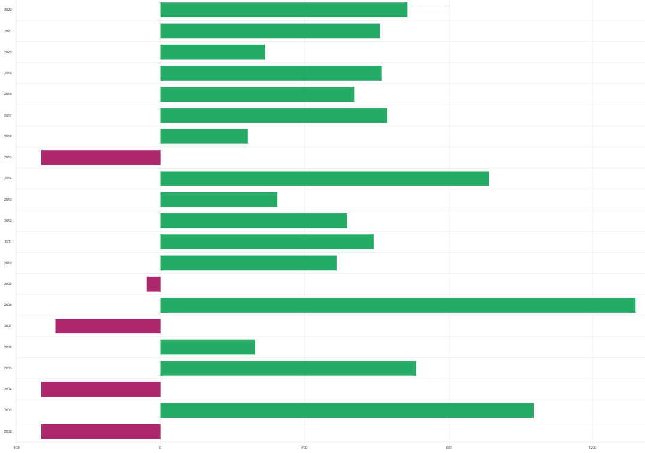
Pasture, Rangeland, & Forage (PRF)
We can run custom quotes, including historical averages and optimizer tools to help customers select the best intervals for their operation.
Indemnity Chart- Hale County, Grid 16613, 20-year history:

Slide 18
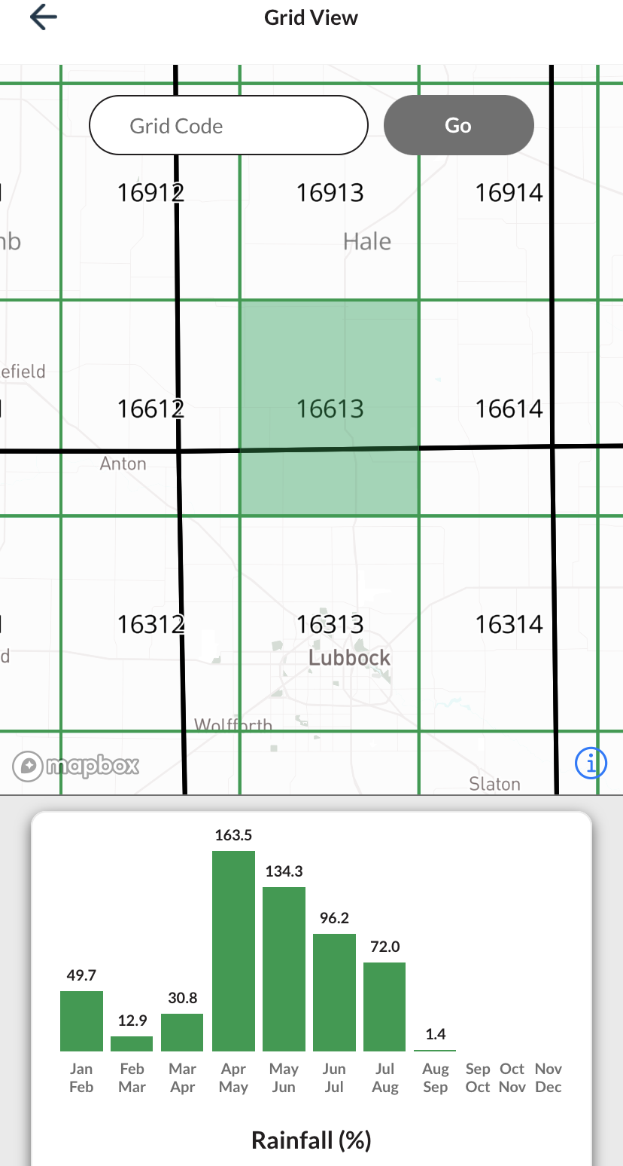
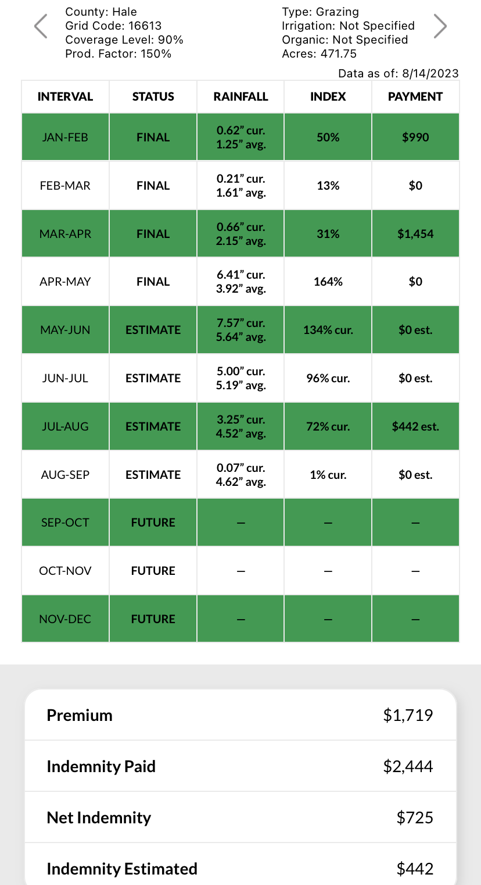
Pasture, Rangeland, & Forage (PRF)
Custom mobile app is available to all PRF customers.
View any grid in the US.
View policy-specific current rainfall AND estimated indemnity anytime.

Slide 19
Annual Forage
Protects annually planted acres used as livestock feed or fodder, with an intended use of grazing or hay, from lack of rainfall.
Producers have the option to divide liability into 12 monthly index intervals targeting when precipitation is crucial to their growing season.
Sales Deadline: July 15th

Slide 20
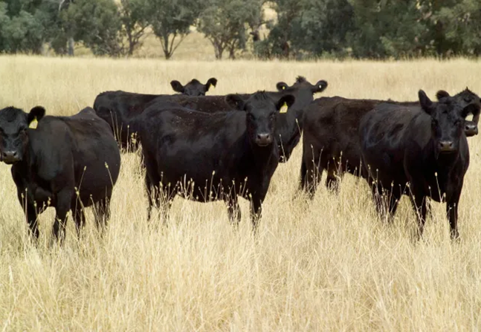
Livestock Risk Protection (LRP)
A price-risk management tool to cover against declining market prices.
Producers may choose from a variety of coverage levels and insurance periods to correspond with sell times of market weights.
Available for feeder cattle, fed cattle and swine.
Sales Deadline: Available anytime

Slide 21
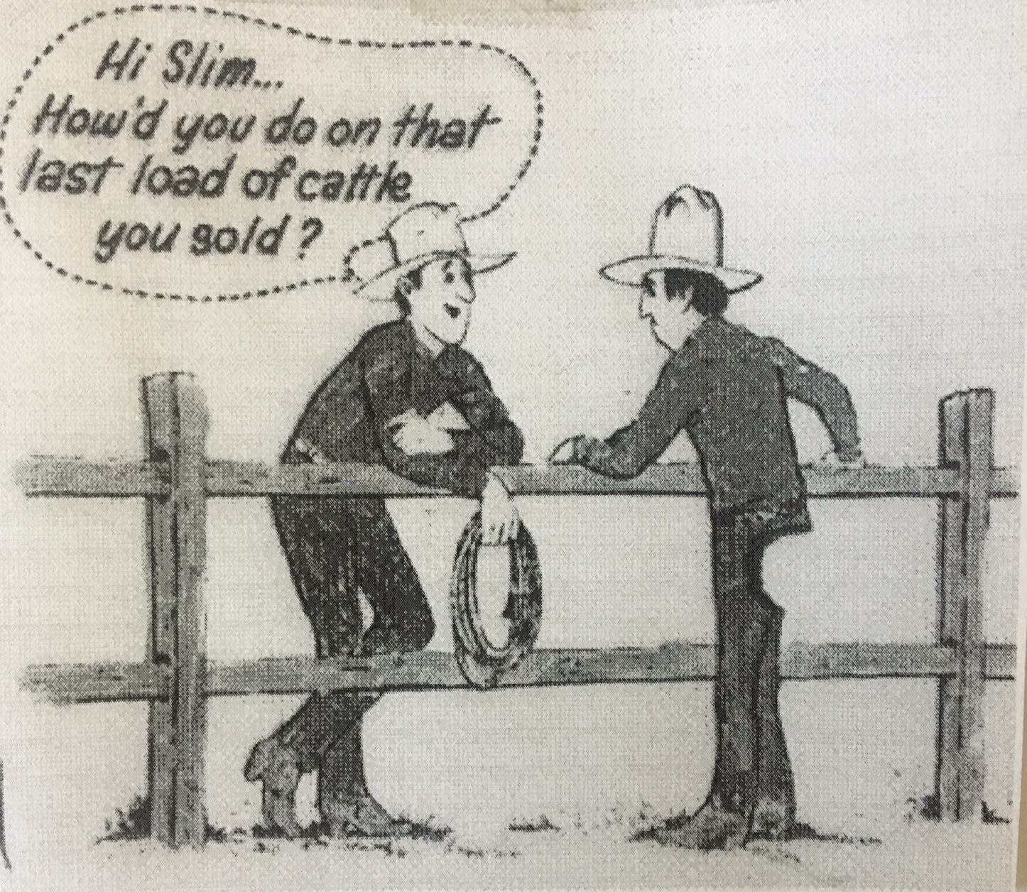
Livestock Risk Protection (LRP)
2 Step Process:
Application (free to complete)
Specific Coverage Endorsement: contains the details of the coverage

Slide 22
Livestock Gross Margin (LGM)
Cattle insurance policy using futures prices to determine expected gross margin and the actual gross margin.
Policy doesn’t insure against death loss or any other loss or damage to producer’s cattle.
Options available for cattle, dairy and swine.
Sales Deadline: Available anytime

Slide 23
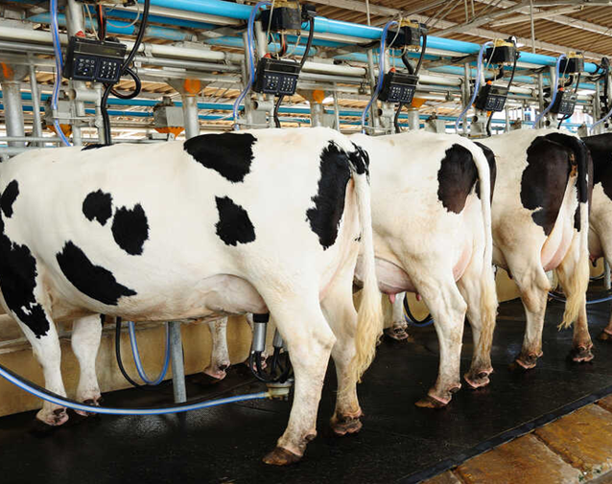
Dairy Revenue Protection (DRP)
Risk management tool insuring against declines in quarterly revenue from milk sales.
Select from a variety of coverage levels and pricing by class or component
Sales Deadline: Available anytime

Slide 24
Conclusion
Insurance for producers is a critical component of managing their operations.
Successful producers utilize insurance as a risk management tool and understand the value of partnering with a trusted agent.
Insurance products are continually changing and evolving.
How can we help you minimize your risk?

Slide 25
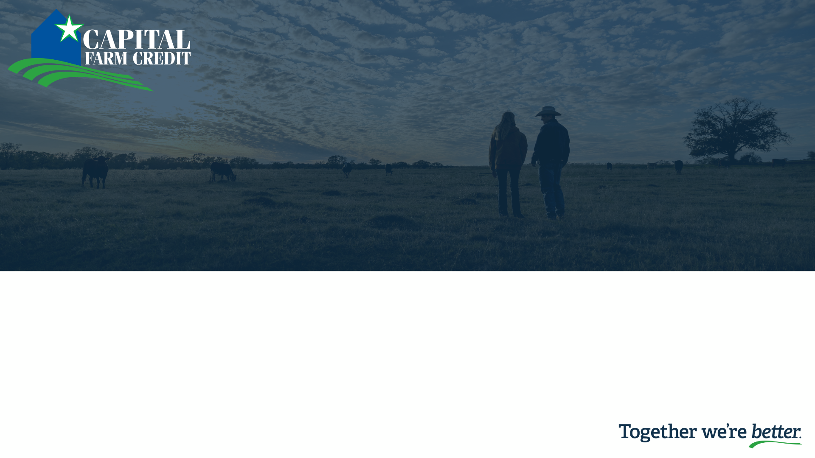
Questions?
www.CapitalFarmCredit.com

